Slide 1


LEARNER GUIDE · COURSE SLIDES
Agentic AI Automation with n8n
WSQ Course Code: TGS-2023035977
Conducted by Tertiary Infotech Academy Pte Ltd · UEN 201200696W
Version v47 · 8 Aug 2026
© 2026 Tertiary Infotech Academy Pte Ltd. All rights reserved. · www.tertiarycourses.com.sg

Slide 2
TRAQOM · SSG DIGITAL ATTENDANCE
Digital Attendance (Mandatory)
• It is mandatory to take the AM, PM and Assessment digital attendance for WSQ-funded courses.
• The trainer/administrator will display the digital attendance QR code generated from the SSG portal.
• Scan the QR code with your mobile phone camera and submit your attendance.
• A minimum of 75% attendance is required to be eligible for assessment and funding.
Agentic AI Automation with n8n · TGS-2023035977
© 2026 Tertiary Infotech Academy Pte Ltd
1

Slide 3
YOUR TRAINER · GENERAL
About the Trainer
NAME
____________________________________________
?
TITLE / DESIGNATION
____________________________________________
QUALIFICATIONS
____________________________________________
Your Trainer
AREAS OF EXPERTISE
____________________________________________
General Trainer template —
to be completed by the trainer
TRAINING & INDUSTRY EXPERIENCE
____________________________________________
CONTACT
____________________________________________
Agentic AI Automation with n8n · TGS-2023035977
© 2026 Tertiary Infotech Academy Pte Ltd
2

Slide 4
YOUR TRAINER
About the Trainer
ROLE
Principal Trainer, Tertiary Infotech Academy Pte. Ltd.
AA
QUALIFICATIONS
PhD — specialises in AI, automation and software engineering.
Dr. Alfred Ang
DELIVERS
WSQ courses on AI agents, automation (n8n) and app development.
Principal Trainer
Tertiary Infotech Academy Pte. Ltd.
FOUNDER
Founder and lead instructor at Tertiary Infotech / Tertiary Courses.
Agentic AI Automation with n8n · TGS-2023035977
© 2026 Tertiary Infotech Academy Pte Ltd
3

Slide 5
ICE-BREAKER
Let's Know Each Other
• Your name and organisation / role.
• Your experience with automation or AI tools (if any).
• What you want to automate after this course.
Agentic AI Automation with n8n · TGS-2023035977
© 2026 Tertiary Infotech Academy Pte Ltd
4

Slide 6
HOUSEKEEPING
Ground Rules
Set your mobile phone to silent mode.
Participate actively — no question is too small.
1
2
Mutual respect: agree to disagree.
One conversation at a time.
3
4
Be punctual; return from breaks on time.
75% attendance is required.
5
6
Agentic AI Automation with n8n · TGS-2023035977
© 2026 Tertiary Infotech Academy Pte Ltd
5

Slide 7
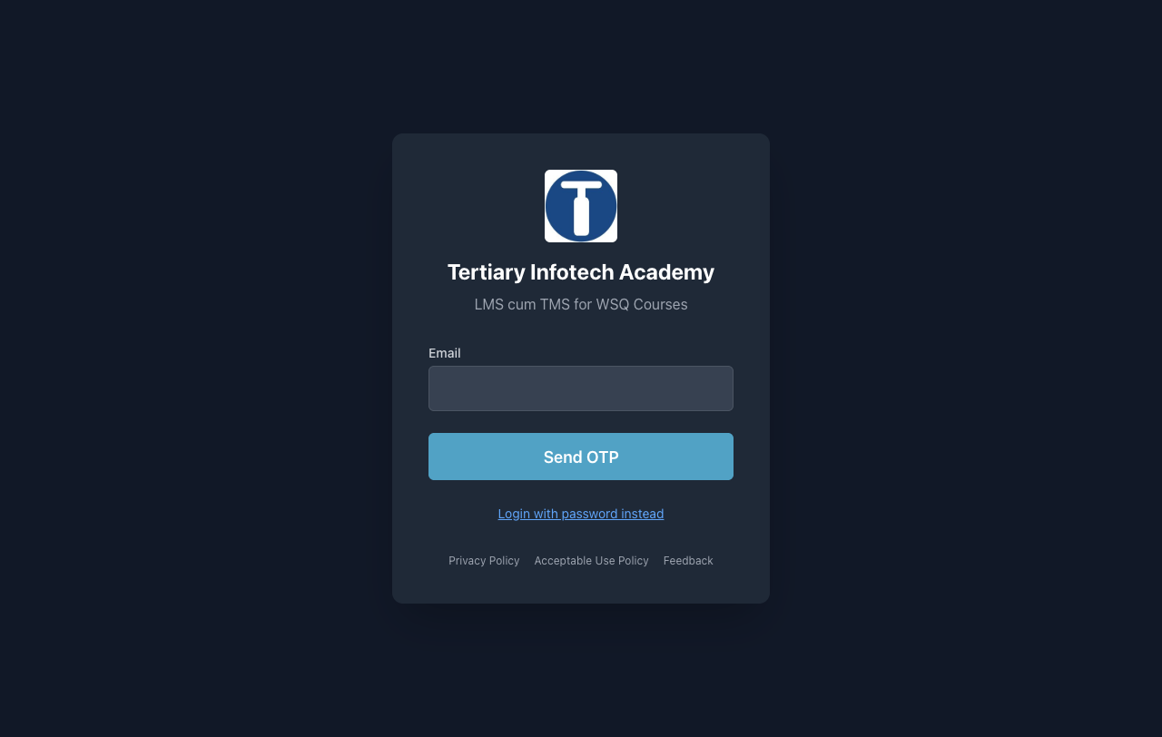
COURSE PORTAL
Download Course Material
• Go to lms-tms.tertiaryinfotech.com.
• Enter your registered email and click Send OTP.
• Key in the one-time password from your inbox to log in.
• Open this course to download the slides and Learner Guide.
• Keep them open — the assessment is open book.
• Attendance and assessment submission also happen here.
Agentic AI Automation with n8n · TGS-2023035977
© 2026 Tertiary Infotech Academy Pte Ltd
6

Slide 8
GET THE WORKFLOWS
Download the Course Flows (GitHub)
1
Open the course repo: github.com/tertiarycourses/TGS-2023035977-Agentic-AI-Automation-with-n8n
2
Code ▾ → Download ZIP (or git clone) — all workflows are in the labs/ folder.
3
In n8n: Workflows → Add workflow → ... → Import from File → pick the activity .json.
4
After importing, re-select YOUR OWN credentials on each node, then Save & Publish.
Agentic AI Automation with n8n · TGS-2023035977
© 2026 Tertiary Infotech Academy Pte Ltd
7

Slide 9
SCHEDULE
Lesson Plan — 3 Days, 9:30am–6:30pm
Day 1 — Automate, then add AI
Day 2 — Connect it to the world
Day 3 — Govern, then prove it
• Topic 1: n8n basics — triggers, actions, data
• Activities 1, 2, 3a, 3b — forms, storage, logic
• Topic 2: AI Agents — model · memory · tools · instructions
• Activities 4a, 4b — Telegram agent + Data Table tool
• Topic 3: Webhooks — Activity 5 (website chatbot)
• Topic 4: APIs & HTTP — Activity 6 (day-trading agent)
• Topic 5: RAG — Activities 7a, 7b (grounded agents)
• Topic 6: Security — human-in-the-loop + guardrails
• Activities 8a, 8b, 8c — the HR Service Portal
• Topic 7: Mini capstone + presentations
• Written Assessment (SAQ) 1 hr · Practical (PP) 1 hr
Each day runs 9:30am–6:30pm — 8 instructional hours with a 1-hour lunch; tea breaks counted within.
Agentic AI Automation with n8n · TGS-2023035977
© 2026 Tertiary Infotech Academy Pte Ltd
8

Slide 10
WHAT YOU'LL ACHIEVE
Learning Outcomes
1
LO1: Build automated workflows in n8n using triggers, actions, nodes and flows.
2
LO2: Design AI agents with LLMs, memory and tools, triggered from chat / Telegram.
3
LO3: Apply Retrieval-Augmented Generation (RAG) to ground agents in your documents.
4
LO4: Integrate external systems via webhooks, APIs and HTTP requests.
5
LO5: Apply human-in-the-loop and guardrails to secure agentic automations.
Agentic AI Automation with n8n · TGS-2023035977
© 2026 Tertiary Infotech Academy Pte Ltd
9

Slide 11
COURSE JOURNEY
Twelve Connected Labs
1
Act 1 — Form → Email: your first automation, on a real flyer.
2
Act 2 — Data Table: store every submission, not just forward it.
3
Act 3a/3b — IF logic: route Yes/No to storage or a thank-you.
4
Act 4a — Telegram AI agent: model + memory + instruction.
5
Act 4b — Agent + tool: answers HR questions from a Data Table.
6
Act 5 — Webhook: your agent behind a public website chatbot.
7
Act 6 — APIs: live candles + news → Buy / Sell / Hold calls.
8
Act 7a — RAG: upload a PDF, ask the bot in Telegram.
9
Act 7b — RAG at scale: 20 brochures in a real vector DB.
10
Act 8a–8c — HR portal: approval gate, dashboard, guardrails.
11
Capstone — design and demo your own end-to-end automation.
Agentic AI Automation with n8n · TGS-2023035977
© 2026 Tertiary Infotech Academy Pte Ltd
10

Slide 12
BEFORE THE ASSESSMENT
Briefing for Assessment
• Place phones and other materials under the table or on the floor.
• No photos or recording of assessment scripts.
• No discussion during the assessment.
• Use a black/blue pen for hard-copy assessments.
• No liquid paper / correction tape.
• Scripts are collected when time is up.
Agentic AI Automation with n8n · TGS-2023035977
© 2026 Tertiary Infotech Academy Pte Ltd
11

Slide 13
FINAL ASSESSMENT
Assessment
• Written Assessment (SAQ) — 1 hour.
• Practical Performance (PP) — 1 hour.
• Format: Open Book — slides, Learner Guide and approved materials only.
• A mini capstone project is presented on Day 3.
• An appeal process is available if required.
Agentic AI Automation with n8n · TGS-2023035977
© 2026 Tertiary Infotech Academy Pte Ltd
12

Slide 14
ON ASSESSMENT DAY
Assessment Flow
1
2
3
4
5
▶
▶
▶
▶
TRAQOM survey — scan the QR code on the LMS
Assessment digital attendance — scan the SSG QR
Sit WA (SAQ) then PP — open book
Submit your answers on the LMS
Sign the Assessment Summary Record
Agentic AI Automation with n8n · TGS-2023035977
© 2026 Tertiary Infotech Academy Pte Ltd
13

Slide 15
01
TOPIC 1
Workflow Automation with n8n
What n8n is · triggers · data-processing nodes · JSON and expressions · executions
Applied in Activities 1, 2, 3a and 3b
Agentic AI Automation with n8n · TGS-2023035977
© 2026 Tertiary Infotech Academy Pte Ltd
14

Slide 16
TOPIC 1 · WORKFLOW AUTOMATION
What Is n8n?
A workflow automation platform: connect apps, data and AI on one visual canvas — no-code to full-code.
1
Build visually
2
Run anywhere
3
AI-native
Drag nodes onto a canvas and wire them together. 400+ app integrations, plus HTTP and Code nodes when no integration exists.
Free cloud trial at n8n.io, or self-host with Docker. Webhooks, schedules and chat triggers work the same in both.
AI Agent and LangChain nodes are built in — attach any LLM (OpenAI, Gemini, Claude), memory, tools and vector stores.
One canvas to connect apps, data and AI — automation and agents without gluing code by hand.
Agentic AI Automation with n8n · TGS-2023035977
© 2026 Tertiary Infotech Academy Pte Ltd
15

Slide 17
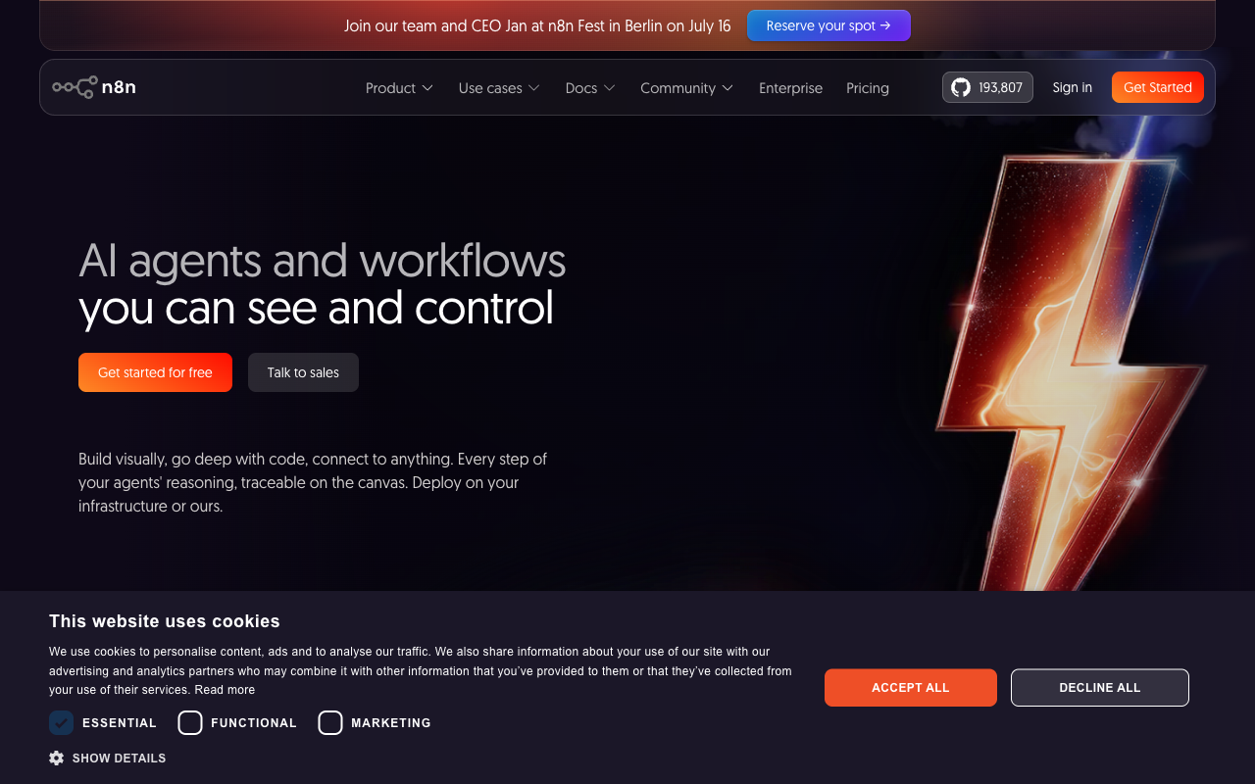
THE PLATFORM
n8n.io
• n8n is an open, fair-code workflow automation platform.
• Free cloud trial at n8n.io, or self-host with Docker.
• Same visual editor in both.
• This course: start on the cloud trial, keep the Docker option for after.
Agentic AI Automation with n8n · TGS-2023035977
© 2026 Tertiary Infotech Academy Pte Ltd
16

Slide 18
TOPIC 1 · WORKFLOW AUTOMATION
What Automation Removes
Automation is not 'the same work faster' — it removes the hand-offs where a person re-types what another system already knows.
MANUAL
Form filled in
Someone reads it
Re-typed into Excel
Someone remembers to reply
▶
▶
▶
AUTOMATED
Form submitted
Flow triggered
Row written
Reply sent
▶
▶
▶
Consistency
Traceability
Capacity
The same input produces the same output, every time, at 3am.
Every run leaves an execution history someone can read a year later.
People move up to judgement calls; the machine does the re-typing.
Automate the hand-offs first — that is where time and errors live.
Agentic AI Automation with n8n · TGS-2023035977
© 2026 Tertiary Infotech Academy Pte Ltd
17

Slide 19
TOPIC 1 · WORKFLOW AUTOMATION
Every Workflow Is the Same Shape
Trigger first, then actions in order, with data flowing left to right. Only the nodes change.
TRIGGER
what starts it
ACTION
do the work
ACTION
do more work
OUTPUT
reply, store or notify
▶
▶
▶
1
One trigger
2
Actions are ordered
3
Data flows as JSON
A workflow has exactly one entry point. Change the trigger and you have a different flow — the actions may not change at all.
Each action runs after the one before it and can read the outputs of every node before it.
Every node passes a list of JSON items to the next — the same structure in every lab.
Trigger, actions, output. Learn this once in Activity 1 and every later lab is a variation.
Agentic AI Automation with n8n · TGS-2023035977
© 2026 Tertiary Infotech Academy Pte Ltd
18

Slide 20
TOPIC 1 · WORKFLOW AUTOMATION
Trigger Nodes — What Is Allowed to Start a Workflow
The trigger you choose is a statement about who or what may start the process.
1
Manual Trigger
2
Schedule Trigger
3
Form Trigger
Click Execute Workflow — for building and testing, and for one-off jobs like the Activity 7b ingestion run.
A clock starts the flow — cron or interval. Reports, reminders, nightly syncs.
n8n hosts a web form for you; each submission starts a run. Activities 1–3.
4
Webhook
5
Chat / Telegram Trigger
6
App & Email Triggers
External systems call a URL you expose. Websites and apps — Activities 5, 7b, 8.
Each chat message starts a run — n8n's chat UI or your Telegram bot. Activities 4, 6, 7a.
On new Gmail, new Sheet row, new Drive file, new IMAP email — react to changes in apps you already use.
Pick the trigger by asking: who or what should be allowed to start this process?
Agentic AI Automation with n8n · TGS-2023035977
© 2026 Tertiary Infotech Academy Pte Ltd
19

Slide 21
TOPIC 1 · WORKFLOW AUTOMATION
Triggers Used in This Course
Every lab's trigger, and why that trigger is the right front door.
Trigger
Where
Why it fits
Form Trigger
Activities 1, 2, 3a, 3b
A visitor RSVP must start the flow
Telegram Trigger
Activities 4a, 4b, 6, 7a
Each bot message is one conversation turn
Webhook — POST
Activities 5, 7b, 8a, 8c
A website sends data and waits for a reply
Webhook — GET
Activity 8b
The dashboard pulls JSON from a URL
Manual Trigger
Activity 7b ingestion
A human runs the document load once
Schedule and app triggers follow the same pattern — swap the front door, keep the flow.
Agentic AI Automation with n8n · TGS-2023035977
© 2026 Tertiary Infotech Academy Pte Ltd
20

Slide 22
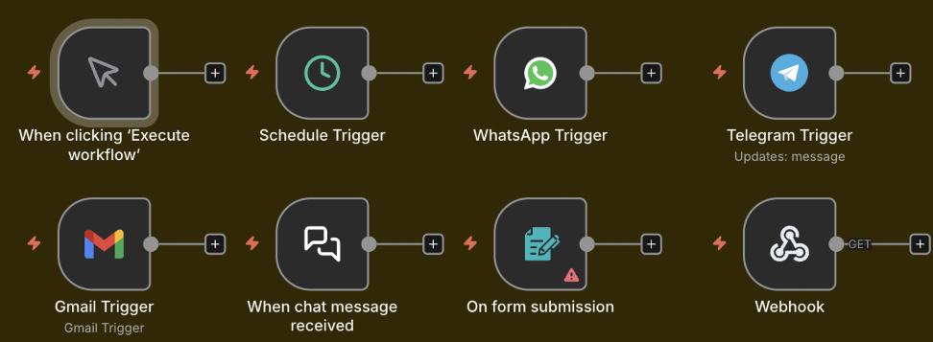
TOPIC 1 · WORKFLOW AUTOMATION
Trigger Nodes on the n8n Canvas
n8n trigger nodes: Manual · Schedule · WhatsApp · Telegram · Gmail · Chat · Form · Webhook
Agentic AI Automation with n8n · TGS-2023035977
© 2026 Tertiary Infotech Academy Pte Ltd
21

Slide 23
TOPIC 1 · WORKFLOW AUTOMATION
Data-Processing Nodes — The Workhorses
Between the trigger and the output, these nodes shape, route and transform the data.
1
Edit Fields (Set)
2
IF / Switch
3
Filter
4
Merge
Add, rename or reshape fields — the node you reach for first when data is the wrong shape.
Branch the flow: IF gives true/false paths; Switch gives one path per case.
Let only matching items continue — drop the rest of the list.
Combine two branches — append rows, match by key, or choose one side.
5
Split Out / Aggregate
6
Code
7
Loop / Wait
8
HTTP Request
Turn one item holding a list into many items — and back again.
JavaScript or Python for the 5% a built-in node cannot do.
Process items in batches; pause a flow for time or an event.
Call any API on the internet — the universal escape hatch.
Most flows are: trigger → reshape (Set) → decide (IF) → act (app node). Reach for Code last.
Agentic AI Automation with n8n · TGS-2023035977
© 2026 Tertiary Infotech Academy Pte Ltd
22

Slide 24

TOPIC 1 · WORKFLOW AUTOMATION
Data-Processing Nodes on the Canvas
If · Switch · Filter · Edit Fields · Split Out · Aggregate · Merge · Loop · Date & Time · Execute Workflow · Wait · Code
Agentic AI Automation with n8n · TGS-2023035977
© 2026 Tertiary Infotech Academy Pte Ltd
23

Slide 25
TOPIC 1 · WORKFLOW AUTOMATION
Where the Data Goes — Storage & App Actions
Action nodes that write the result somewhere useful.
1
Data Table
2
Google Sheets / Excel
n8n's built-in spreadsheet — instant, no credential. Trial Data Tables are NOT permanent; use for class demos.
A real spreadsheet you keep — OAuth2 credential, Append Row. The persistent upgrade in Activity 3b.
3
Gmail / Outlook
4
Vector Store
Send (and in Activity 8a, Send and Wait for Response) — email as an output and as an approval gate.
Store embeddings for RAG — in-memory for demos, Pinecone / Supabase / Qdrant for production.
Anything you must keep goes to external storage — trial Data Tables vanish with the trial.
Agentic AI Automation with n8n · TGS-2023035977
© 2026 Tertiary Infotech Academy Pte Ltd
24

Slide 26
TOPIC 1 · WORKFLOW AUTOMATION
JSON — How Data Travels Between Nodes
Every node passes a list of items; each item is a JSON object of key/value pairs.
• JSON (JavaScript Object Notation) is a simple text format for data.
• Values can be text, numbers, true/false, lists [ ] or nested objects { }.
• Most APIs send and receive JSON — so does every n8n node.
• Click any node to inspect its input and output JSON.
ONE FORM SUBMISSION AS JSON
{
"Name": "Alice Tan",
"Email": "alice@corp.com",
"Attending": "Yes",
"Pax": 2
}
Read any value later with an expression: {{ $json.Name }} → "Alice Tan"
Agentic AI Automation with n8n · TGS-2023035977
© 2026 Tertiary Infotech Academy Pte Ltd
25

Slide 27
TOPIC 1 · WORKFLOW AUTOMATION
Expressions — The Token, Not the Text
An expression references a value that will exist at run time — it is resolved fresh on every run.
Trigger runs
a submission arrives
Outputs exist
Name, Email, Attending…
Later node references them
{{ $json.Name }}
Value arrives at run time
different every run
▶
▶
▶
✓ Mapped with the picker
✗ Typed as plain text
Drag the field from the input panel — n8n writes the expression for you and shows a live preview of the resolved value.
Type 'Name' as literal text and every email says 'Name'. If the path is wrong the value resolves to empty — not to an error.
Use expressions in any field — subject lines, URLs, conditions. Drag, don't type.
Agentic AI Automation with n8n · TGS-2023035977
© 2026 Tertiary Infotech Academy Pte Ltd
26

Slide 28
TOPIC 1 · WORKFLOW AUTOMATION
Test vs Production Executions
The same workflow runs in two modes — know which one you are looking at.
TEST — in the editor
PRODUCTION — Active toggle ON
• Click Execute Workflow to run once.
• Data is shown live on the canvas, node by node.
• Pin a node's output to freeze it while you build downstream.
• Perfect for building — nothing needs to be Active.
• Runs automatically when the trigger fires.
• Nothing appears on the canvas — runs are logged in Executions.
• Every run records status, timing and full data per node.
• This is what your users experience.
The Executions list is the honest account of what happened — debug from there, not from memory.
Agentic AI Automation with n8n · TGS-2023035977
© 2026 Tertiary Infotech Academy Pte Ltd
27

Slide 29

TOPIC 1 · WORKFLOW AUTOMATION
Execution History
Executions tab — each run shows status, duration, ID and the full data at every node
Agentic AI Automation with n8n · TGS-2023035977
© 2026 Tertiary Infotech Academy Pte Ltd
28

Slide 30
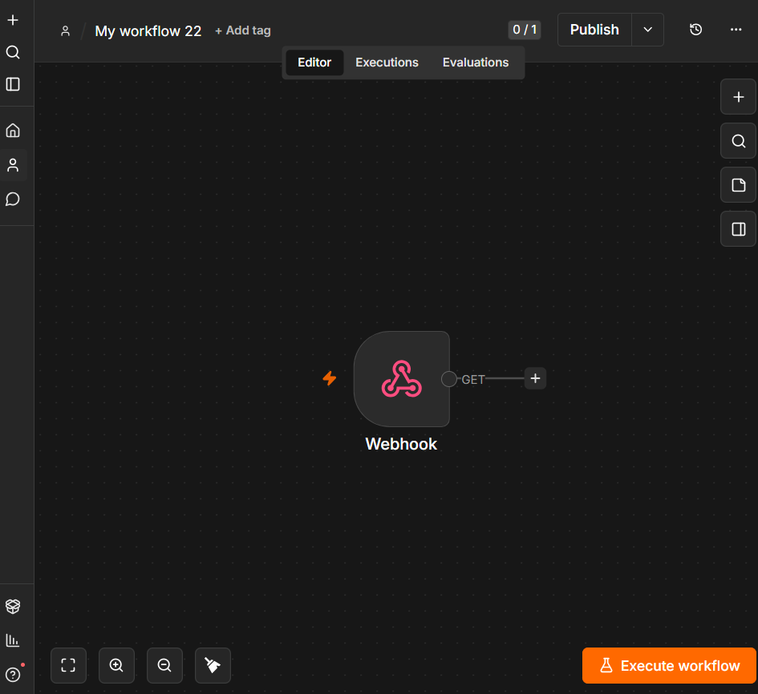
TOPIC 1 · WORKFLOW AUTOMATION
The n8n Editor
n8n canvas: left sidebar navigation · centre canvas · node toolbar · Editor / Executions / Evaluations tabs
Agentic AI Automation with n8n · TGS-2023035977
© 2026 Tertiary Infotech Academy Pte Ltd
29

Slide 31
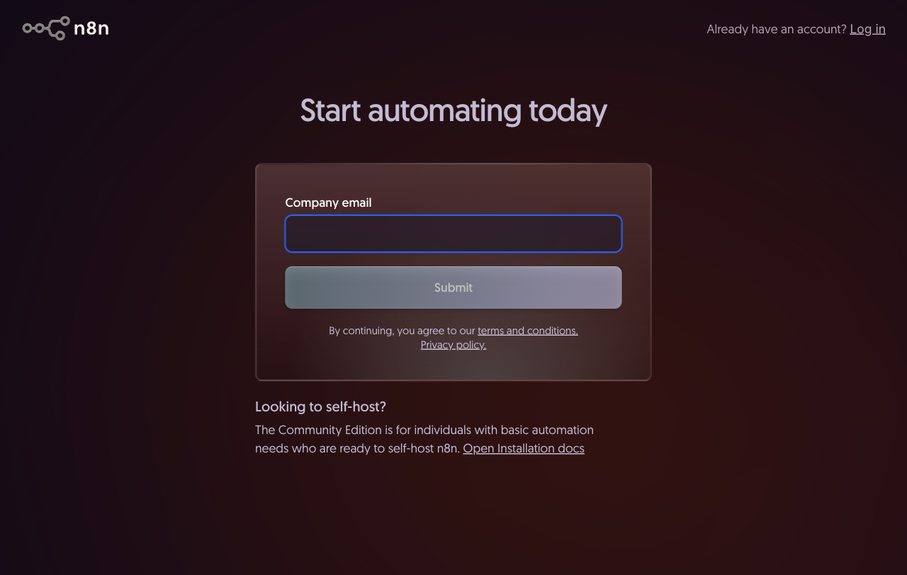
YOUR LOGIN · CLOUD INSTANCE
Sign Up for n8n Cloud
• Go to app.n8n.cloud/register in your browser.
• Enter your company email and click Submit.
• Open the verification email from n8n and click the link to confirm.
• Set your password and complete the short profile questions.
• n8n creates your workspace at <name>.app.n8n.cloud and opens the editor.
• The free trial runs 14 days — no credit card needed.
Agentic AI Automation with n8n · TGS-2023035977
© 2026 Tertiary Infotech Academy Pte Ltd
30

Slide 32
TOPIC 1 · WORKFLOW AUTOMATION
Credentials — Connect Your Accounts Once
Nodes reference credentials by name; set them up once under Credentials → Add credential.
1
Email
2
LLM
Gmail or Outlook via OAuth2 — used from Activity 1 onward.
OpenAI / Google Gemini API key — powers every AI agent from Activity 4.
3
Telegram
4
Google Sheets
Bot token from @BotFather — the chat front door for Activities 4, 6, 7a.
OAuth2 to your Google account — persistent storage in Activity 3b.
Imported workflows keep credential NAMES only — always re-select your own after importing.
Agentic AI Automation with n8n · TGS-2023035977
© 2026 Tertiary Infotech Academy Pte Ltd
31

Slide 33

TOPIC 1 · LAB WORKFLOW
Activity 1 — Flyer with QR Code (Form → Email)
Collect a visitor's RSVP with a hosted n8n Form and email it to the admin — then put the form's QR code on a real event flyer.
Form Trigger
visitor submits the RSVP
Gmail — Send
admin receives the details
▶
ACT 1
Flyer with QR Code (Form → Email)
Form Trigger → Gmail · Gmail OAuth2 credential · full steps in the Learner Guide
Agentic AI Automation with n8n · TGS-2023035977
© 2026 Tertiary Infotech Academy Pte Ltd
32

Slide 34


ACT 1 · GROUP ACTIVITY
Sample Flyers from Past Students
Network event
Bowling party
Agentic AI Automation with n8n · TGS-2023035977
© 2026 Tertiary Infotech Academy Pte Ltd
33

Slide 35
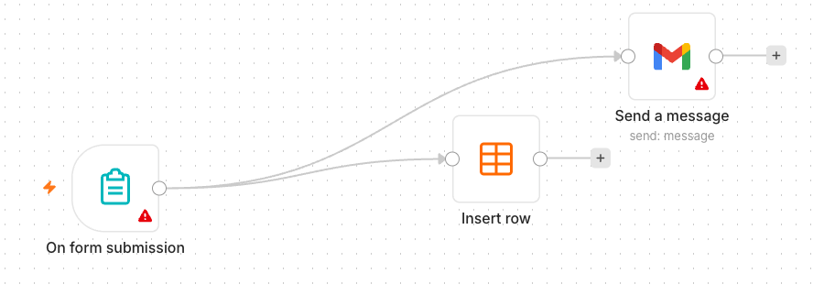
TOPIC 1 · LAB WORKFLOW
Activity 2 — Capture Submissions in a Data Table
Extend Activity 1 so every submission is also saved — your first taste of storing data, not just forwarding it.
Form Trigger
same RSVP form
Data Table — Insert Row
every submission saved
Gmail — Send
admin still notified
▶
▶
ACT 2
Capture Submissions in a Data Table
Form Trigger → Data Table + Gmail · columns mapped with {{ $json.… }} expressions · steps in the Learner Guide
Agentic AI Automation with n8n · TGS-2023035977
© 2026 Tertiary Infotech Academy Pte Ltd
34

Slide 36
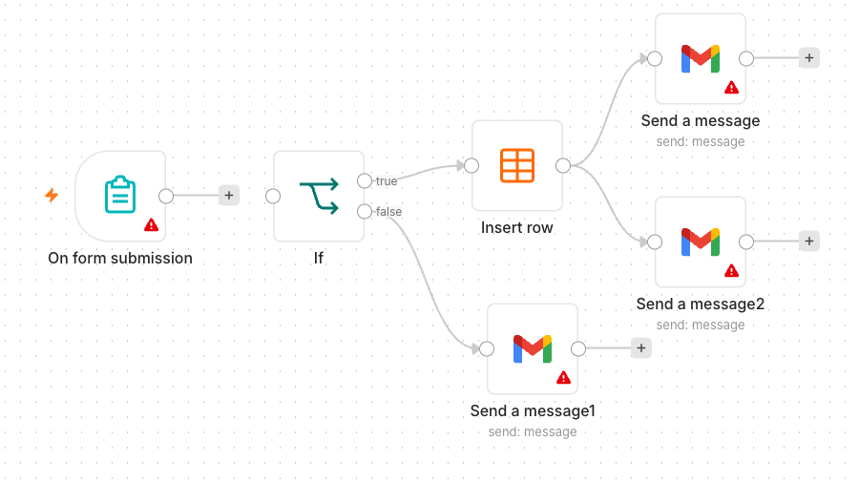
TOPIC 1 · LAB WORKFLOW
Activity 3a — Conditional Response (Data Table)
Add decision-making: attending guests are saved; everyone else gets a polite thank-you email.
Form Trigger
+ Attending? Yes/No field
IF
Attending = Yes ?
Data Table
YES → save the RSVP
Gmail
NO → thank-you email
▶
▶
▶
ACT 3a
Conditional Response (Data Table)
Form → IF → Data Table / Gmail · both branches must be built · steps in the Learner Guide
Agentic AI Automation with n8n · TGS-2023035977
© 2026 Tertiary Infotech Academy Pte Ltd
35

Slide 37
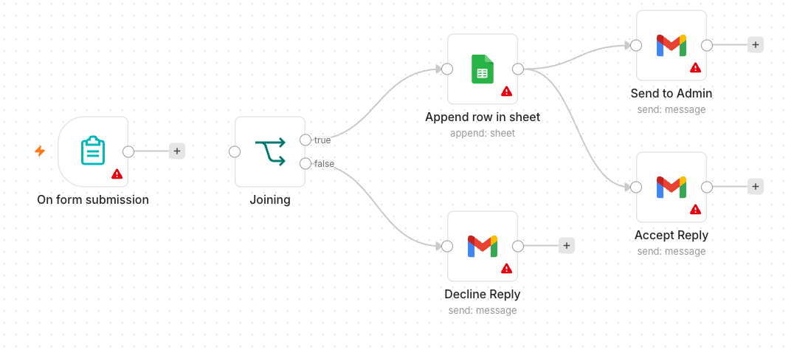
TOPIC 1 · LAB WORKFLOW
Activity 3b — Conditional Response (Google Sheets)
Same logic, persistent storage: the YES branch appends to a real Google Sheet you keep after the trial.
Form Trigger
same form
IF
Attending = Yes ?
Google Sheets — Append
YES → a spreadsheet you keep
Gmail
NO → thank-you email
▶
▶
▶
ACT 3b
Conditional Response (Google Sheets)
Form → IF → Google Sheets / Gmail · Google Sheets OAuth2 · steps in the Learner Guide
Agentic AI Automation with n8n · TGS-2023035977
© 2026 Tertiary Infotech Academy Pte Ltd
36

Slide 38
Lunch Break
1 hour · see you at 2:00 pm
Agentic AI Automation with n8n · TGS-2023035977
© 2026 Tertiary Infotech Academy Pte Ltd
37

Slide 39
02
TOPIC 2
AI Agents
Generative vs agentic AI · model, memory, tools, instructions · model parameters · MCP
Applied in Activities 4a and 4b
Agentic AI Automation with n8n · TGS-2023035977
© 2026 Tertiary Infotech Academy Pte Ltd
38

Slide 40
TOPIC 2 · AI AGENTS
Generative AI vs Agentic AI
GENERATIVE AI — answers
AGENTIC AI — acts
• You ask; it writes one answer.
• No memory of your systems, no actions.
• Quality depends on what you paste into the prompt.
• Example: ChatGPT summarising a document.
• Works toward a goal, not just one reply.
• Calls tools: looks up data, calls APIs, writes records.
• Holds a conversation with memory.
• Example: a bot that checks the Employees table and answers.
Generative AI produces content. Agentic AI decides and does — which is why it needs governance.
Agentic AI Automation with n8n · TGS-2023035977
© 2026 Tertiary Infotech Academy Pte Ltd
39

Slide 41
TOPIC 2 · AI AGENTS
Components of an AI Agent
Four parts, one hub: the agent node wires them together — and only some are under your direct control.
MODEL
MEMORY
The LLM 'brain' — interprets language, reasons, chooses the next step. gpt-4.1-mini in this course.
Keeps the conversation — follow-up questions still make sense. Window buffer per chat/session.
THE AI AGENT
plans · decides · calls tools
TOOLS
INSTRUCTIONS
Abilities it may use: Data Table lookups, vector stores, HTTP calls, sub-workflows.
The system message — identity, scope, rules and refusals. Always in force.
Model + Memory + Tools + Instructions — every agent in this course is exactly these four parts.
Agentic AI Automation with n8n · TGS-2023035977
© 2026 Tertiary Infotech Academy Pte Ltd
40

Slide 42
TOPIC 2 · AI AGENTS
The Model — Popular LLM Providers
Any chat model plugs into the same AI Agent node — swap the brain, keep the agent.
Provider
Models
Notes
OpenAI
gpt-4.1, gpt-4.1-mini, gpt-4o
Course default: gpt-4.1-mini
Google
Gemini 2.x Flash / Pro
Used for embeddings in Activity 7
Anthropic
Claude (Opus, Sonnet, Haiku)
Strong reasoning and safety
Meta
Llama 3.x
Open weights — self-hostable
Mistral
Mistral / Mixtral
Open weights — EU option
Pick by task: small fast models for classification and guardrails, larger models for reasoning.
Agentic AI Automation with n8n · TGS-2023035977
© 2026 Tertiary Infotech Academy Pte Ltd
41

Slide 43
TOPIC 2 · AI AGENTS
Model Parameters — Temperature and Friends
Settings on the chat-model node shape how the model answers — the most important is temperature.
1
Temperature 0 – 0.3
2
Temperature ≈ 0.7
3
Temperature 1.0 +
Deterministic and repeatable. Use for classification, guardrails, data extraction — automation that must give the same decision twice.
Balanced — natural-sounding chat with some variety. The default for customer-facing assistants.
Creative and surprising. Marketing copy and brainstorming — never for decisions.
1
Top-p
2
Max tokens
3
Frequency / presence penalty
Alternative sampling control — limits choices to the most probable tokens. Tune temperature OR top-p, not both.
Caps the length of the reply — protects cost and keeps chat answers short.
Discourage repetition and nudge new topics — useful for long generations.
For business automation keep temperature LOW — the same input should produce the same decision.
Agentic AI Automation with n8n · TGS-2023035977
© 2026 Tertiary Infotech Academy Pte Ltd
42

Slide 44
TOPIC 2 · AI AGENTS
Memory — Why the Agent Remembers
Without memory every message is a stranger; with it, 'what about tomorrow?' makes sense.
Msg 1: 'Any leave left?'
agent answers: 12 days
Stored in memory
keyed by chat / session ID
Msg 2: 'What about Bob?'
agent knows the topic is leave
Window slides
only the last N turns kept
▶
▶
▶
Simple (buffer window) memory
Session key
Keeps the last N exchanges of THIS conversation — n8n's default, used in all course agents.
Memory is per chat ID — two Telegram users never see each other's context.
Memory is conversation context — it is NOT long-term knowledge. Facts live in tools and documents (RAG).
Agentic AI Automation with n8n · TGS-2023035977
© 2026 Tertiary Infotech Academy Pte Ltd
43

Slide 45
TOPIC 2 · AI AGENTS
Tools — What the Agent May Do
Attach tools to the agent's Tool input; the model decides when to call one, based on your description.
1
Data Table / Sheets tool
2
Vector Store tool
Look up structured records — the Employees table in Activity 4b.
Retrieve document chunks for grounded answers — the knowledge_base in Activity 7.
3
HTTP Request tool
4
Sub-workflow tool
Call any external API mid-conversation — prices, weather, CRM.
Wrap an entire n8n workflow as one callable tool — your own logic, on demand.
The tool DESCRIPTION is how the agent knows when to call it — write it for the model, not for a developer.
Agentic AI Automation with n8n · TGS-2023035977
© 2026 Tertiary Infotech Academy Pte Ltd
44

Slide 46
TOPIC 2 · AI AGENTS
Instructions — The Four Parts That Constrain
The system message is always in force. Every good agent instruction in this course states four things.
1
Identity
2
Source rules
Who the agent is and what it must never do. 'You are HR Buddy, the HR assistant for staff of Acme Pte Ltd.'
Where answers come from. 'Answer ONLY from the Employees tool / the uploaded documents.'
3
Refusals
4
Escalation
What is out of bounds, stated positively. 'Do not reveal salaries or another person's records.'
What to do at the boundary. 'If unsure, say so and direct the user to hr@acme.com.'
Vague instructions produce confident wrong answers — every rule you skip, the model improvises.
Agentic AI Automation with n8n · TGS-2023035977
© 2026 Tertiary Infotech Academy Pte Ltd
45

Slide 47
TOPIC 2 · AI AGENTS
Good vs Bad Instructions
The same bot, two system messages — one is testable, one is a hope.
✗ TOO VAGUE
✓ CONSTRAINED
"You are a helpful assistant. Answer the user's questions politely."
"You are HR Buddy, the HR assistant for Acme staff.
Answer only questions on leave policy, payroll dates and claims.
Use the Employees tool for any staff lookup — never answer from general knowledge.
Never reveal salaries or another employee's personal data.
If you are not sure, say so and direct the user to hr@acme.com."
No identity · no sources · no refusals · no escalation.
It will happily invent leave balances and reveal other people's data — politely.
Identity · source rules · refusals · escalation — you can test each line by trying to break it.
Agentic AI Automation with n8n · TGS-2023035977
© 2026 Tertiary Infotech Academy Pte Ltd
46

Slide 48
TOPIC 2 · AI AGENTS
MCP — Model Context Protocol
An open standard that gives agents a common plug for tools and data — instead of one custom integration per pair.
AI Agent
any MCP-capable client
MCP Client
speaks the protocol
MCP Server
exposes tools + data
Your Systems
databases, APIs, files
▶
▶
▶
Without MCP
With MCP
Every agent × every tool needs its own custom integration — N agents and M tools means N × M connectors to build and maintain.
Build ONE MCP server per system; any MCP-capable agent can use it. N + M pieces, and tools become reusable across agents.
MCP is like USB-C for AI tools — one connector, many devices.
Agentic AI Automation with n8n · TGS-2023035977
© 2026 Tertiary Infotech Academy Pte Ltd
47

Slide 49
TOPIC 2 · AI AGENTS
MCP in n8n
MCP SERVER TRIGGER — n8n serves tools
MCP CLIENT TOOL — n8n consumes tools
• Expose your n8n workflows AS tools over MCP.
• Claude, IDEs or other agents call your flows directly.
• n8n becomes the tool layer for any MCP client.
• Auth via bearer token on the server URL.
• Attach external MCP servers to your n8n AI Agent.
• The agent gains their tools without custom nodes.
• Mix MCP tools with native n8n tools freely.
• Same agent loop — more reach.
Two directions, one protocol: n8n can serve tools to other agents, and borrow tools for its own.
Agentic AI Automation with n8n · TGS-2023035977
© 2026 Tertiary Infotech Academy Pte Ltd
48

Slide 50
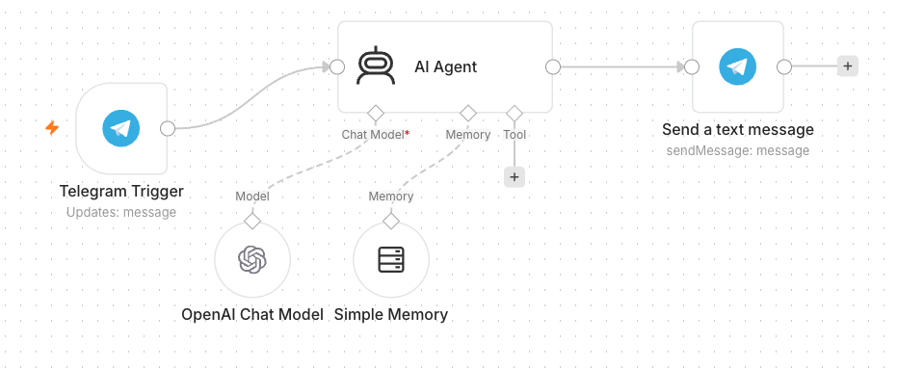
TOPIC 2 · LAB WORKFLOW
Activity 4a — Telegram AI Agent (Customer Service)
Your first agent: a customer-service bot on Telegram — model + memory + a system instruction.
Telegram Trigger
each message to your bot
AI Agent
gpt-4.1-mini + window memory + instruction
Telegram — Send
reply lands in the chat
▶
▶
ACT 4a
Telegram AI Agent (Customer Service)
Telegram bot via @BotFather · OpenAI + Telegram credentials · steps in the Learner Guide
Agentic AI Automation with n8n · TGS-2023035977
© 2026 Tertiary Infotech Academy Pte Ltd
49

Slide 51
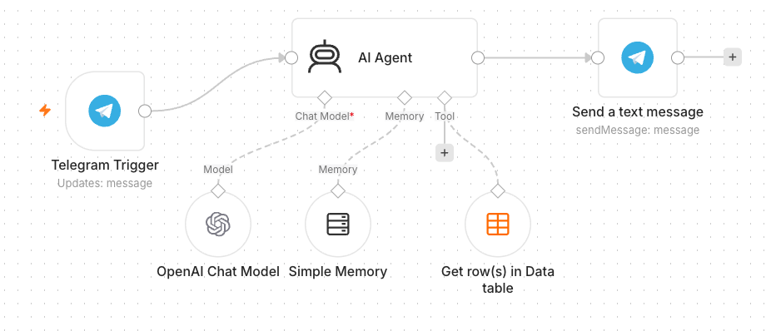
TOPIC 2 · LAB WORKFLOW
Activity 4b — Agent + Data Table Tool (HR Admin)
Give the same agent a tool: an Employees Data Table (100 records) it can query — answers now come from real data.
Telegram Trigger
same bot
AI Agent
+ Employees Data Table tool
Telegram — Send
answers grounded in the table
▶
▶
ACT 4b
Agent + Data Table Tool (HR Admin)
Tool description tells the agent WHEN to use it · instruction updated to route staff questions · steps in the Learner Guide
Agentic AI Automation with n8n · TGS-2023035977
© 2026 Tertiary Infotech Academy Pte Ltd
50

Slide 52
WRAP-UP
End of Day 1 — Recap
• You built form automations, conditional logic and storage (Data Table → Google Sheets).
• You met the agent's four parts — model, memory, tools, instructions — and MCP.
• You shipped a Telegram AI agent, then grounded it in an Employees table.
• Tomorrow: webhooks, external APIs, and RAG.
Agentic AI Automation with n8n · TGS-2023035977
© 2026 Tertiary Infotech Academy Pte Ltd
51

Slide 53
03
TOPIC 3
Webhooks
The inbound URL · GET vs POST · Test vs Production URL · responding to the caller
Applied in Activity 5
Agentic AI Automation with n8n · TGS-2023035977
© 2026 Tertiary Infotech Academy Pte Ltd
52

Slide 54
TOPIC 3 · WEBHOOKS
What Is a Webhook?
A URL your workflow listens on. When the outside world calls it, your workflow runs — the reverse of you calling an API.
Event happens
visitor sends a chat message
HTTP request to your URL
the website POSTs JSON
Workflow runs
n8n receives the data as input
Respond to Webhook
your reply returns to the caller
▶
▶
▶
1
Push, not pull
2
Any caller
3
Paired node
No polling, no schedule — the caller notifies you the moment something happens.
Websites, payment providers, forms, apps — anything that can send an HTTP request.
Webhook starts the flow; Respond to Webhook sends the answer back on the same connection.
A webhook is the reverse of an API call — the outside world calls YOU when an event happens.
Agentic AI Automation with n8n · TGS-2023035977
© 2026 Tertiary Infotech Academy Pte Ltd
53

Slide 55

TOPIC 3 · WEBHOOKS
Webhook Nodes in n8n
Webhook node starts the workflow when called · Respond to Webhook node returns data to the caller
Agentic AI Automation with n8n · TGS-2023035977
© 2026 Tertiary Infotech Academy Pte Ltd
54

Slide 56
TOPIC 3 · WEBHOOKS
Webhook vs HTTP Request — Direction of the Call
WEBHOOK — inbound
HTTP REQUEST — outbound
• An external service calls YOUR workflow.
• You react the moment an event happens.
• The trigger of the flow.
• Activity 5: the website calls your agent.
• YOUR workflow calls an external service.
• You pull data when you choose.
• An action inside the flow.
• Activity 6: your flow calls Twelve Data.
Same HTTP underneath — the only difference is who dials.
Agentic AI Automation with n8n · TGS-2023035977
© 2026 Tertiary Infotech Academy Pte Ltd
55

Slide 57
TOPIC 3 · WEBHOOKS
HTTP Methods on a Webhook — GET vs POST
The method is part of the contract with the caller: where the data rides, and what the call means.
GET — read
POST — send
• Data rides in the URL query string:
– ?email=alice@corp.com
• A browser can call it by just visiting the URL.
• Read in n8n as {{ $json.query.email }}.
• Activity 8b: the dashboard GETs its leave data.
• Data rides in the request body as JSON:
– { "message": "How much is the course?" }
• Used by website chat, forms and app callbacks.
• Read in n8n as {{ $json.body.message }}.
• Activities 5, 7b, 8a, 8c: the site POSTs to the flow.
GET reads, POST sends. Set the method on the Webhook node — the caller must match it.
Agentic AI Automation with n8n · TGS-2023035977
© 2026 Tertiary Infotech Academy Pte Ltd
56

Slide 58
TOPIC 3 · WEBHOOKS
Test URL vs Production URL
Every Webhook node gives you TWO URLs — they behave differently, and mixing them up is the #1 webhook bug.
TEST URL — /webhook-test/…
PRODUCTION URL — /webhook/…
• Works only while you click 'Listen for test event'.
• Handles ONE call, then stops listening.
• The run appears live on the canvas — great for debugging.
• Dies the moment you leave the editor.
• Requires the workflow toggled Active.
• Always on — every call starts a run.
• Runs are logged in the Executions list, not on the canvas.
• This is the URL you give to websites and apps.
Websites must call the PRODUCTION URL of an ACTIVE workflow — the Test URL stops when you leave the editor.
Agentic AI Automation with n8n · TGS-2023035977
© 2026 Tertiary Infotech Academy Pte Ltd
57

Slide 59
TOPIC 3 · WEBHOOKS
Configuring the Webhook Node
Four settings decide whether the browser's call succeeds.
1
Method + Path
2
Allowed Origins (CORS)
GET or POST, and the path that ends your URL — e.g. POST /webhook/hr-chat.
Browsers block cross-site calls unless allowed — set * in class so a local HTML page can call n8n.
3
Response mode
4
Authentication
Immediately (ack), when the flow finishes, or via a Respond to Webhook node — the course flows use Respond to Webhook.
None for demos; Basic / Header / JWT for anything real — a public URL is a public door.
'Failed to fetch' in the browser is usually CORS or a dead Test URL — check both first.
Agentic AI Automation with n8n · TGS-2023035977
© 2026 Tertiary Infotech Academy Pte Ltd
58

Slide 60
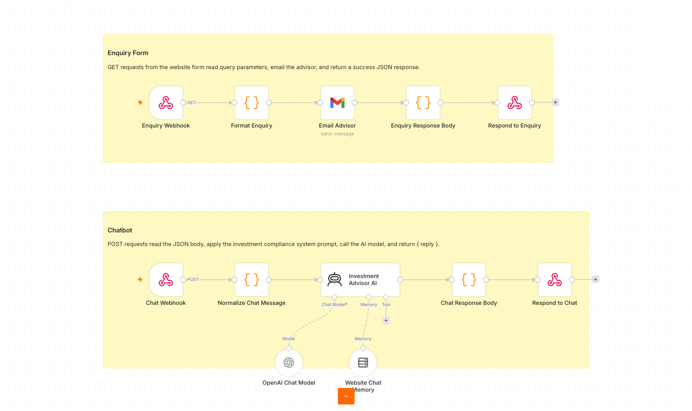
TOPIC 3 · LAB WORKFLOW
Activity 5 — Website Chatbot via Webhook (Investment Advisor)
Put your agent behind a public web page: the enquiry form and the floating chatbot both POST to one n8n webhook.
Webhook — POST
chat + enquiry form call it
AI Agent
compliance instruction — no advice
Respond to Webhook
reply returns to the page
Gmail
enquiry → advisor inbox
▶
▶
▶
ACT 5
Website Chatbot via Webhook (Investment Advisor)
Production URL pasted into script.js · CORS = * · workflow Active · steps in the Learner Guide
Agentic AI Automation with n8n · TGS-2023035977
© 2026 Tertiary Infotech Academy Pte Ltd
59

Slide 61
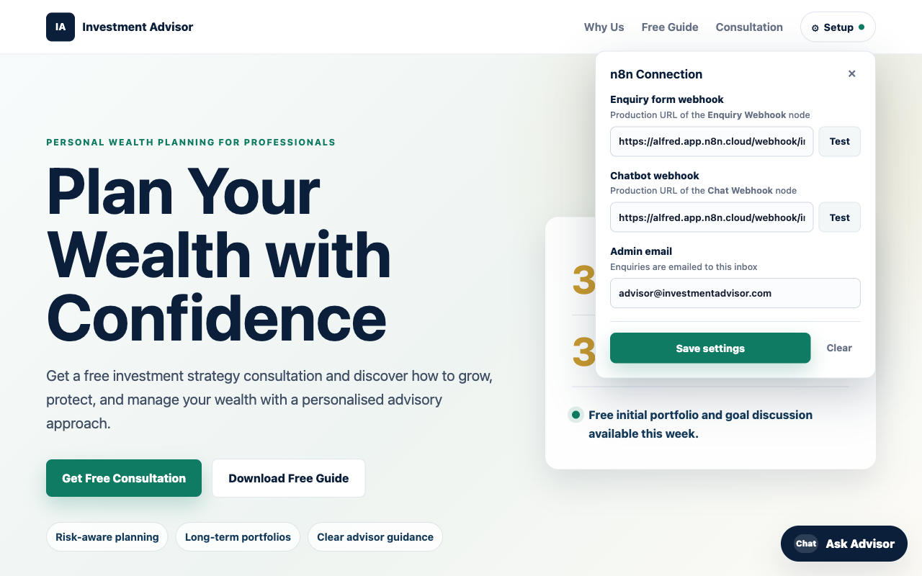
ACT 5 · THE WEBSITE
Activity 5 — The Investment Advisor Website
• A public landing page with an enquiry form and a floating 'Ask Advisor' chatbot.
• Both the form and the chat POST to one n8n Webhook.
• The AI Agent replies in the chat; the advisor is emailed the enquiry.
• Set the webhook Production URL in script.js, then open index.html.
Agentic AI Automation with n8n · TGS-2023035977
© 2026 Tertiary Infotech Academy Pte Ltd
60

Slide 62
Tea Break
15 minutes
Agentic AI Automation with n8n · TGS-2023035977
© 2026 Tertiary Infotech Academy Pte Ltd
61

Slide 63
04
TOPIC 4
APIs and the HTTP Request Node
Calling external services · request anatomy · status codes · API keys
Applied in Activity 6
Agentic AI Automation with n8n · TGS-2023035977
© 2026 Tertiary Infotech Academy Pte Ltd
62

Slide 64
TOPIC 4 · API & HTTP
What Is an API?
A service's front desk: you send a structured request over HTTP, it returns structured data — usually JSON.
Your workflow
the client
HTTP request
method + URL + key + params
API server
processes the request
JSON response
fields your next node can read
▶
▶
▶
1
Live data on demand
2
You dial out
3
One node fits all
Prices, weather, news, CRM records — data your workflow pulls the moment it needs it.
The opposite of a webhook: YOUR flow calls THEIR server, on your schedule.
The HTTP Request node calls any API on the internet — even ones n8n has no integration for.
If a service has an API, n8n can use it — the HTTP Request node is the universal connector.
Agentic AI Automation with n8n · TGS-2023035977
© 2026 Tertiary Infotech Academy Pte Ltd
63

Slide 65
TOPIC 4 · API & HTTP
Anatomy of an HTTP Request
Four parts you configure on the HTTP Request node.
Part
What it is
Activity 6 example
Method
GET (read) · POST (send) · PUT · DELETE
GET — read market candles
URL / endpoint
The address of the resource
api.twelvedata.com/time_series
Headers
Metadata, incl. authentication
(Twelve Data uses a query key instead)
Query params / body
The inputs you send
symbol=AAPL & interval=1min & apikey=…
Store API keys in Credentials — never hard-code them into the URL you share.
Agentic AI Automation with n8n · TGS-2023035977
© 2026 Tertiary Infotech Academy Pte Ltd
64

Slide 66
TOPIC 4 · API & HTTP
Reading the Response — Status Codes
The status code tells you whose problem it is before you read a single byte of the body.
1
2xx — success
2
401 / 403 — auth
200 OK, 201 Created. The JSON body holds your data — map it to the next node.
Bad or missing API key. Check the credential, not the flow.
3
429 — rate limited
4
4xx vs 5xx
Too many calls for your plan — slow down or upgrade. Free tiers hit this fast.
4xx: your request is wrong. 5xx: their server is broken. Retry helps only with 5xx.
4xx = fix your request · 5xx = wait and retry — never guess from the body alone.
Agentic AI Automation with n8n · TGS-2023035977
© 2026 Tertiary Infotech Academy Pte Ltd
65

Slide 67

TOPIC 4 · API & HTTP
The HTTP Request Node
HTTP Request node — configure method, URL, auth, query parameters; the JSON response flows to the next node
Agentic AI Automation with n8n · TGS-2023035977
© 2026 Tertiary Infotech Academy Pte Ltd
66

Slide 68
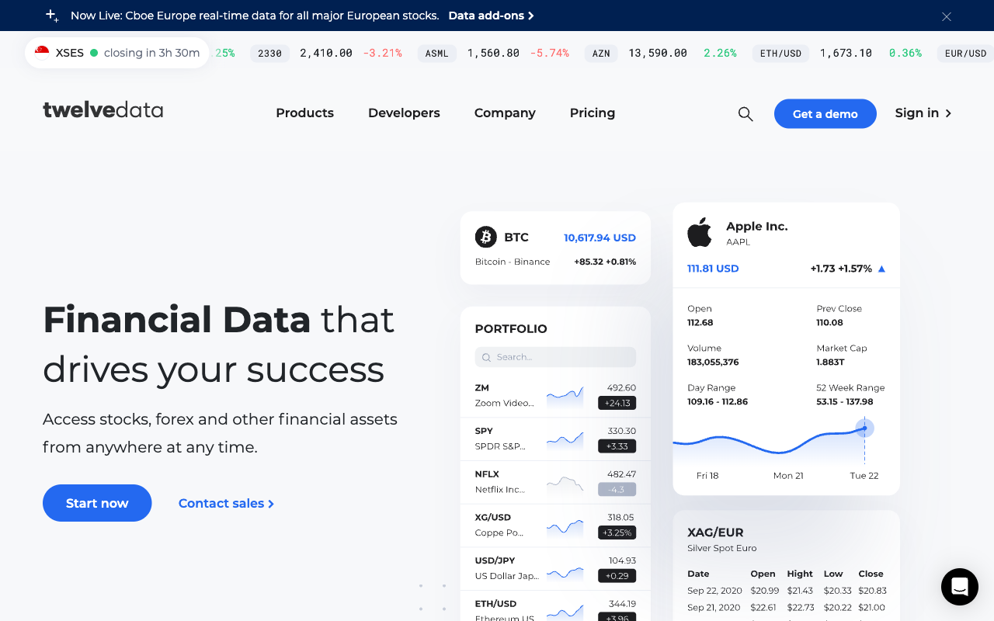
ACT 6 · MARKET DATA API
Twelve Data — Market Data API
• Live stock / forex / crypto data over a simple REST API.
• Sign up (free Basic plan), then Account → API Keys.
• Paste the apikey into the three 'candles' HTTP nodes.
• Free tier: 8 calls/min — enough for the lab.
Agentic AI Automation with n8n · TGS-2023035977
© 2026 Tertiary Infotech Academy Pte Ltd
67

Slide 69
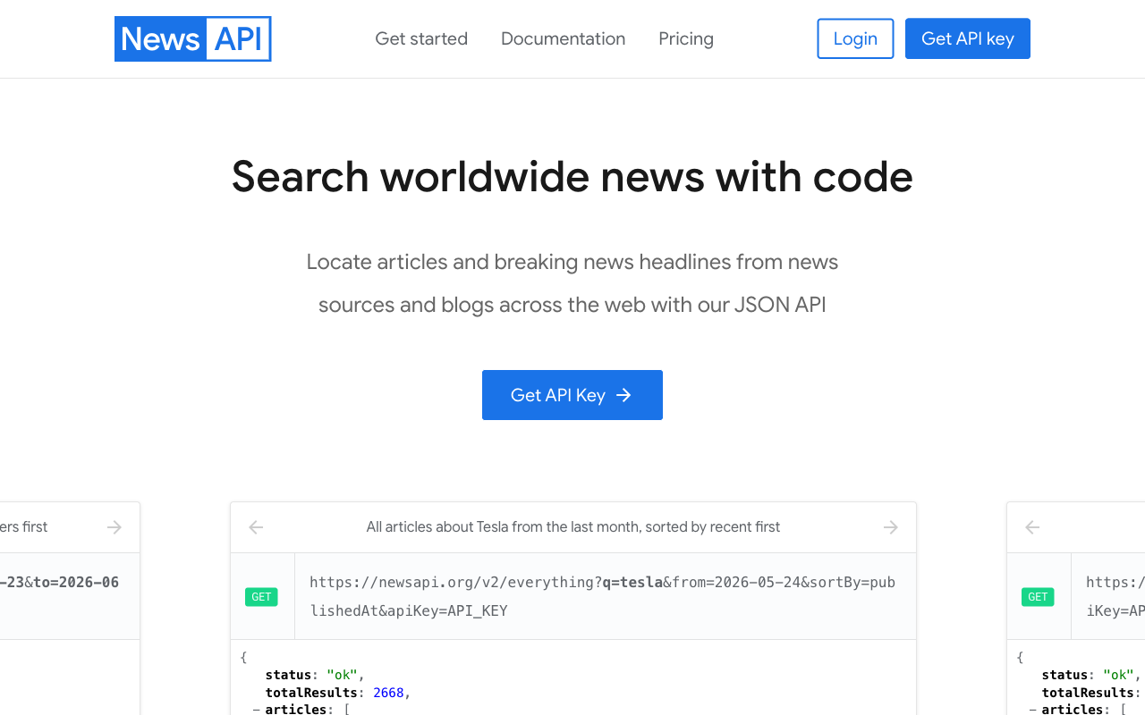
ACT 6 · NEWS API
NewsAPI — Headlines API
• Recent news articles for any search query.
• Register (free Developer plan) and copy your API key.
• Store it as a Query Auth credential (name = apiKey) on the news node.
• The agent reads sentiment from the headlines.
Agentic AI Automation with n8n · TGS-2023035977
© 2026 Tertiary Infotech Academy Pte Ltd
68

Slide 70
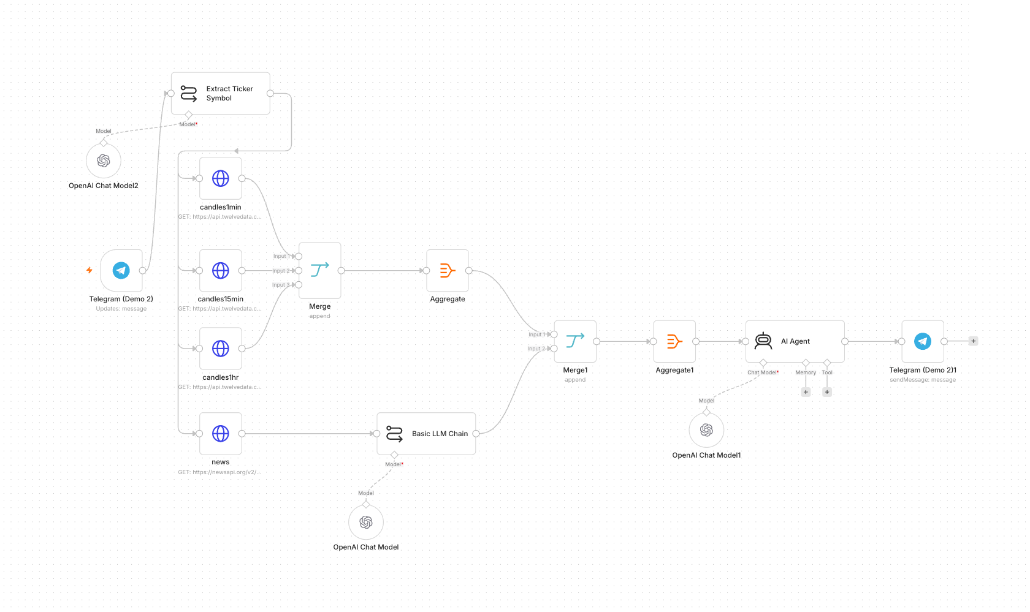
TOPIC 4 · LAB WORKFLOW
Activity 6 — Finance APIs → Telegram (AI Day-Trading Agent)
Ask the bot about a stock: it pulls candles on three timeframes plus news, and the agent argues a Buy / Sell / Hold call.
Telegram Trigger
'Should I buy AAPL?'
Code — Extract Ticker
AAPL
HTTP ×4
candles 1m / 15m / 1h + news
AI Agent
technicals + sentiment → call
Telegram — Send
recommendation + reasoning
▶
▶
▶
▶
ACT 6
Finance APIs → Telegram (AI Day-Trading Agent)
Twelve Data + NewsAPI keys · imported flow, re-select credentials · steps in the Learner Guide
Agentic AI Automation with n8n · TGS-2023035977
© 2026 Tertiary Infotech Academy Pte Ltd
69

Slide 71
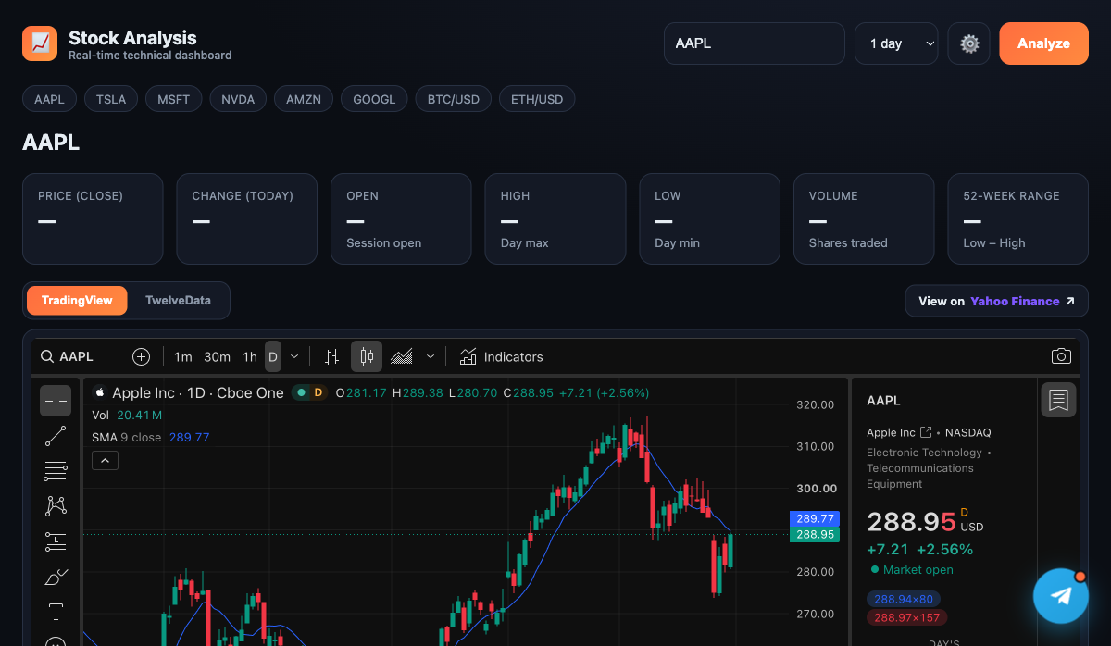
ACT 6 · THE WEBSITE
Activity 6 — The Stock Analysis Dashboard
• A real-time dashboard with a live TradingView candlestick chart.
• Quote stats (price, change, OHLC, volume, 52-week range) from Twelve Data.
• A floating Telegram chat widget opens the AI day-trading agent.
• Save your Twelve Data key + bot username in the Settings panel.
Agentic AI Automation with n8n · TGS-2023035977
© 2026 Tertiary Infotech Academy Pte Ltd
70

Slide 72
WRAP-UP
End of Day 2 — Recap
• You exposed an AI agent to a public website via a webhook (Production URL + CORS).
• You pulled live market and news data through APIs into a Telegram agent.
• Tomorrow: RAG at production scale, human-in-the-loop, guardrails, and the capstone.
Agentic AI Automation with n8n · TGS-2023035977
© 2026 Tertiary Infotech Academy Pte Ltd
71

Slide 73
Lunch Break
1 hour
Agentic AI Automation with n8n · TGS-2023035977
© 2026 Tertiary Infotech Academy Pte Ltd
72

Slide 74
05
TOPIC 5
Retrieval-Augmented Generation
Why retrieval · embeddings and vector stores · chunking and top_k · production vector DBs
Applied in Activities 7a and 7b
Agentic AI Automation with n8n · TGS-2023035977
© 2026 Tertiary Infotech Academy Pte Ltd
73

Slide 75
TOPIC 5 · RAG
Why Retrieval, Rather Than a Bigger Prompt
You could paste all your documents into the instruction — until you can't.
Everything in the prompt
Retrieve, then generate
Beyond a point the model ignores the middle. Every question pays tokens for ALL documents. Add document #41 and quality quietly drops.
Find the two or three chunks that resemble the question and give the model ONLY those. Cost stays flat as the library grows.
Question
embed it
Search the store
nearest chunks
Paste into the prompt
only what matched
Grounded answer
cites what it saw
▶
▶
▶
RAG = retrieval + generation. The retrieval decides whether the generation can possibly be right.
Agentic AI Automation with n8n · TGS-2023035977
© 2026 Tertiary Infotech Academy Pte Ltd
74

Slide 76
TOPIC 5 · RAG
The RAG Pipeline — Ingest Once, Retrieve Every Question
Two phases: ingestion happens once per document; retrieval happens on every question.
INGESTION — once
Documents
Chunk
Embed
Store as vectors
▶
▶
▶
RETRIEVAL — every question
Question
Embed
Nearest top_k
Into the prompt
Answer
▶
▶
▶
▶
Chunk
Embedding
Similarity
top_k
How a document is split — here one brochure = one chunk.
Text as a list of numbers; similar meaning → nearby vectors.
Nearness of two vectors — how 'related' two texts are.
How many chunks come back per question — 3 here.
Four words — chunk, embedding, similarity, top_k — explain every RAG behaviour you will see.
Agentic AI Automation with n8n · TGS-2023035977
© 2026 Tertiary Infotech Academy Pte Ltd
75

Slide 77
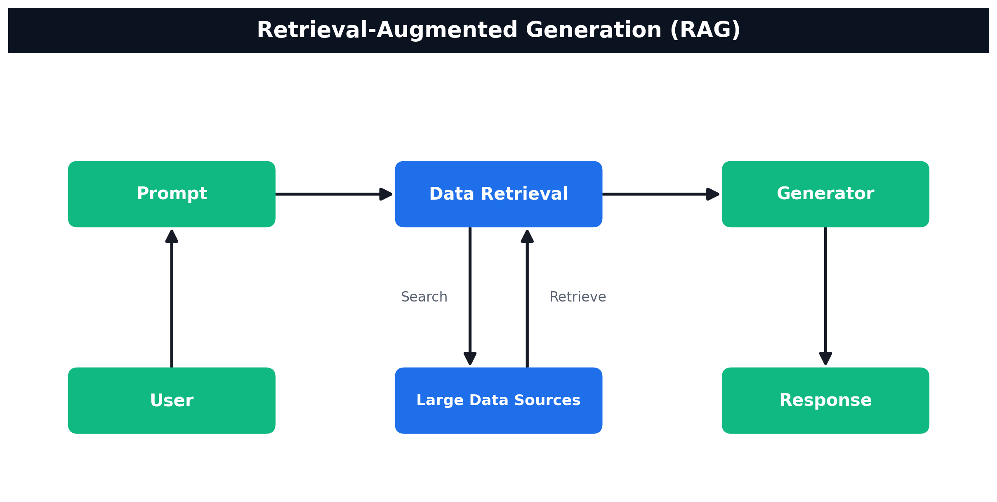
TOPIC 5 · RAG
How RAG Works
User → Prompt → Data Retrieval (search/retrieve over your data sources) → Generator → Response
Agentic AI Automation with n8n · TGS-2023035977
© 2026 Tertiary Infotech Academy Pte Ltd
76

Slide 78
TOPIC 5 · RAG
Vector Databases — Where the Embeddings Live
In-memory for demos; a hosted store for anything that must survive a restart.
Supabase (pgvector)
Pinecone
Qdrant
What it is
Postgres + extension
Managed SaaS index
Open-source vector DB
Setup
SQL table + function
Create an index — no schema
Docker or Qdrant Cloud
Best for
Teams already on Postgres
Zero-ops, scales fast
Full control, self-hosted
Course embedding
OpenAI 1536-dim
Gemini 3072-dim
OpenAI 1536-dim
THE DIMENSION RULE
The store's dimension MUST equal the embedding model's output — OpenAI text-embedding-3-small = 1536, Gemini gemini-embedding-001 = 3072. Mismatched dimensions are the #1 cause of failed inserts.
Swap the store, keep the RAG flow — but ingestion and retrieval must use the SAME embedding model.
Agentic AI Automation with n8n · TGS-2023035977
© 2026 Tertiary Infotech Academy Pte Ltd
77

Slide 79
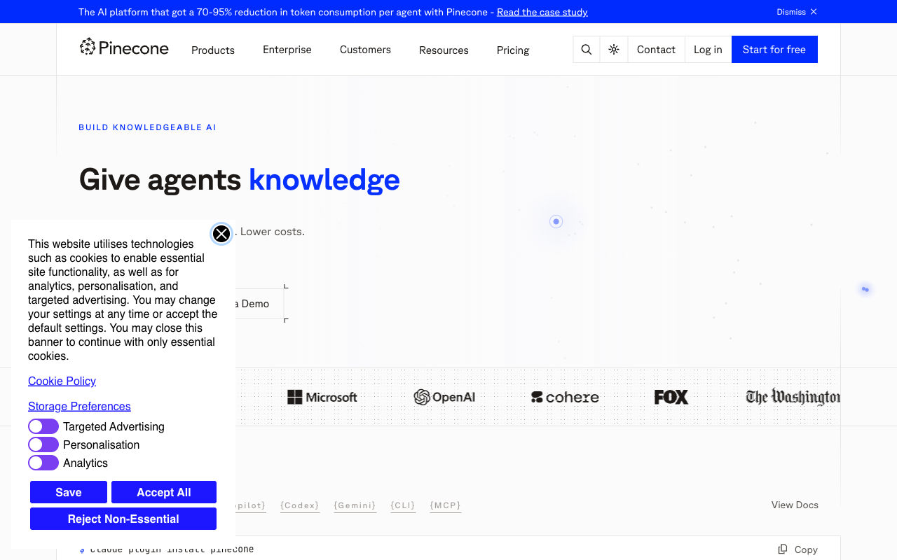
ACT 7b · VECTOR DATABASE
Pinecone — Example Managed Store
• Pinecone is a managed (cloud) vector database for RAG.
• Free 'Starter' tier is enough for this lab.
• Create an index: Dimensions = 3072 (Gemini), Metric = cosine.
• Upload and retrieval must use the same namespace.
Agentic AI Automation with n8n · TGS-2023035977
© 2026 Tertiary Infotech Academy Pte Ltd
78

Slide 80
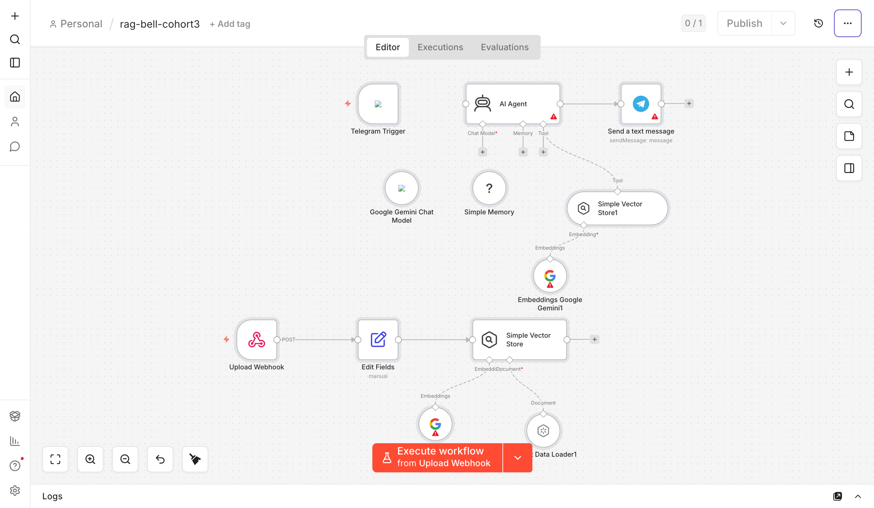
TOPIC 5 · LAB WORKFLOW
Activity 7a — RAG Chatbot: Upload a PDF, Ask in Telegram
The full RAG loop, no code: a web page ingests your IT-Support FAQ; a Telegram bot answers only from that document.
Web Uploader
PDF text extracted in browser
Upload Webhook
POST to n8n
Gemini Embeddings
chunk + embed
Vector Store
in-memory; replaced per upload
▶
▶
▶
Telegram Trigger
'How do I reset my password?'
AI Agent
knowledge_base retriever tool
Telegram — Send
answers only from the document
▶
▶
ACT 7a
RAG Chatbot: Upload a PDF, Ask in Telegram
Gemini credential on 3 nodes · off-topic questions are refused · steps in the Learner Guide
Agentic AI Automation with n8n · TGS-2023035977
© 2026 Tertiary Infotech Academy Pte Ltd
79

Slide 81
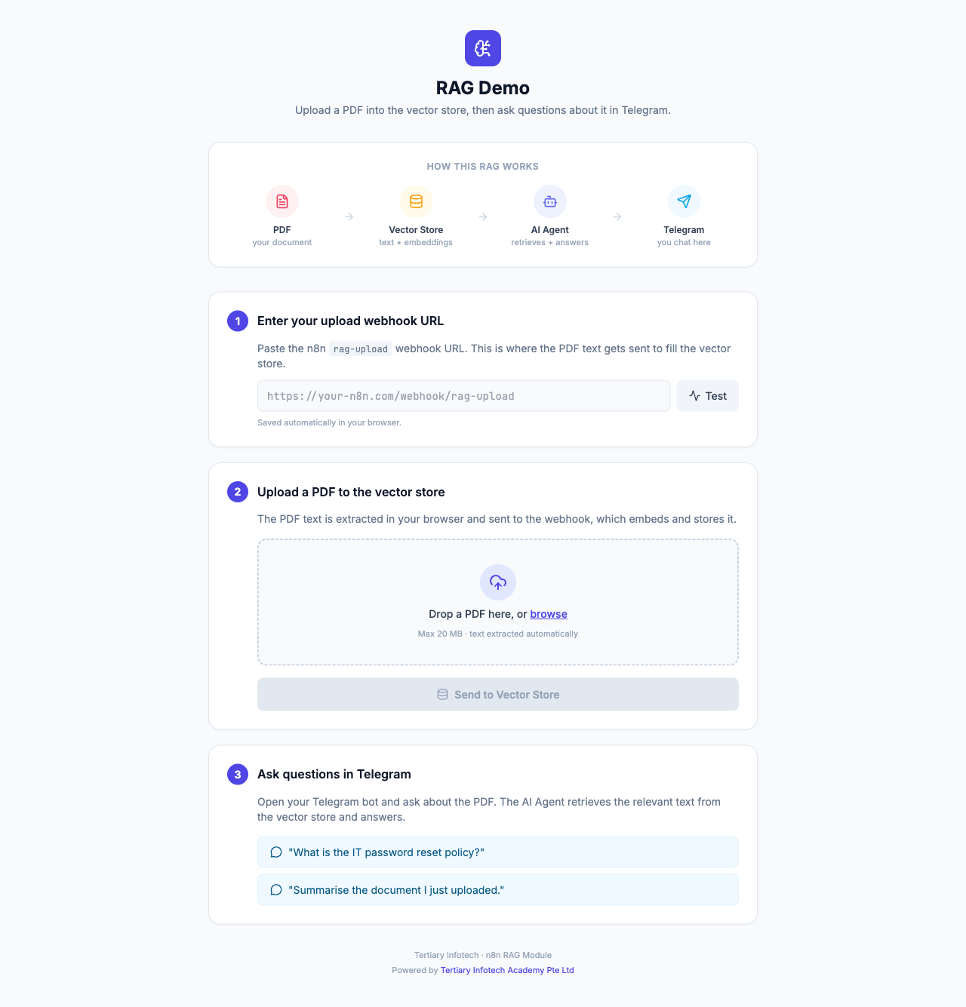
ACT 7a · INGESTION
Activity 7a — The Upload Page
• A single-page uploader extracts PDF text in the browser with PDF.js.
• Paste your n8n rag-upload webhook URL and click Test.
• Drop the IT-Support FAQ PDF and Send to Vector Store to ingest it.
• No build step — just open the HTML file.
Agentic AI Automation with n8n · TGS-2023035977
© 2026 Tertiary Infotech Academy Pte Ltd
80

Slide 82
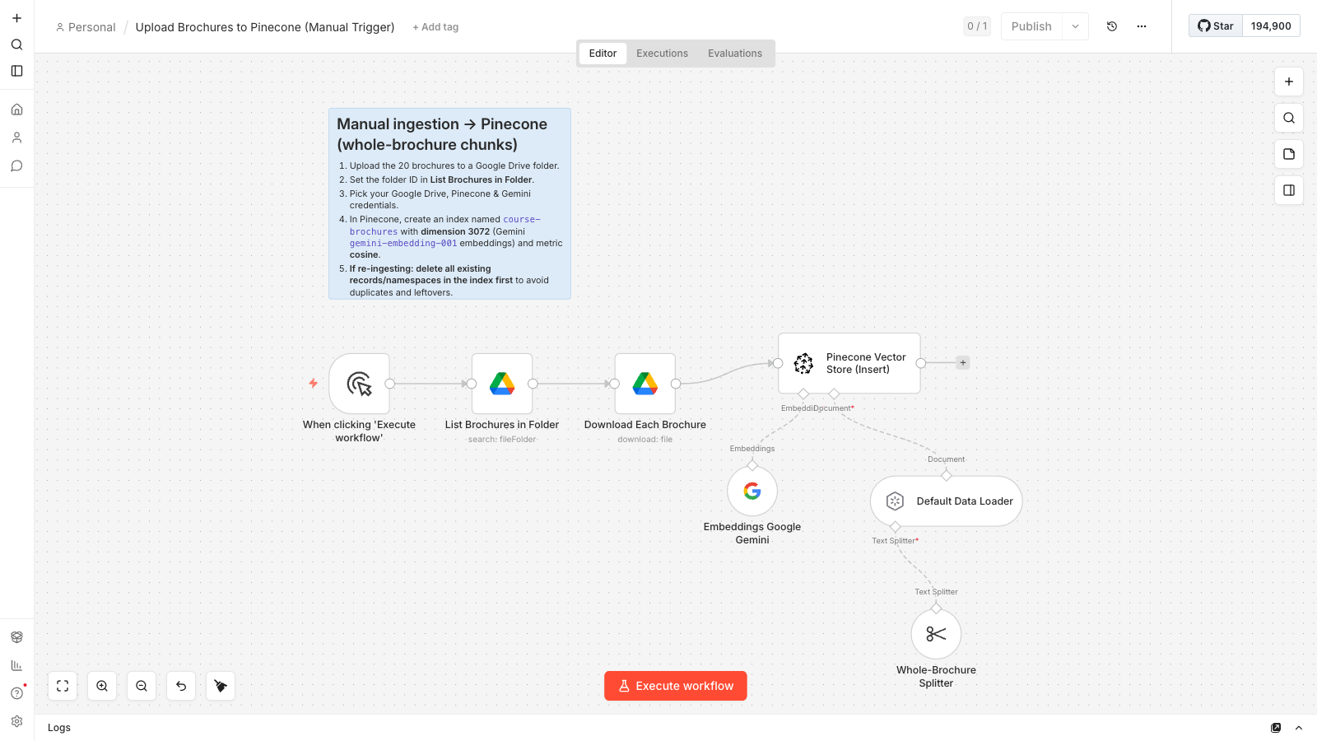
TOPIC 5 · LAB WORKFLOW
Activity 7b — Ingestion: 20 Brochures into a Vector DB
Cook & Bake Academy: load 20 course brochures from Google Drive into your chosen vector database — run once.
Manual Trigger
run once
Google Drive
list + download 20 brochures
Split + Embed
1 brochure = 1 chunk · Gemini 3072-d
Vector Store — Insert
index: course-brochures
▶
▶
▶
Shown: Pinecone ingestion. Supabase & Qdrant flows are identical except the store node + OpenAI 1536-d embeddings.
ACT 7b
Ingestion: 20 Brochures into a Vector DB
Choose Supabase / Pinecone / Qdrant · 20 vectors after the run · steps in the Learner Guide
Agentic AI Automation with n8n · TGS-2023035977
© 2026 Tertiary Infotech Academy Pte Ltd
81

Slide 83
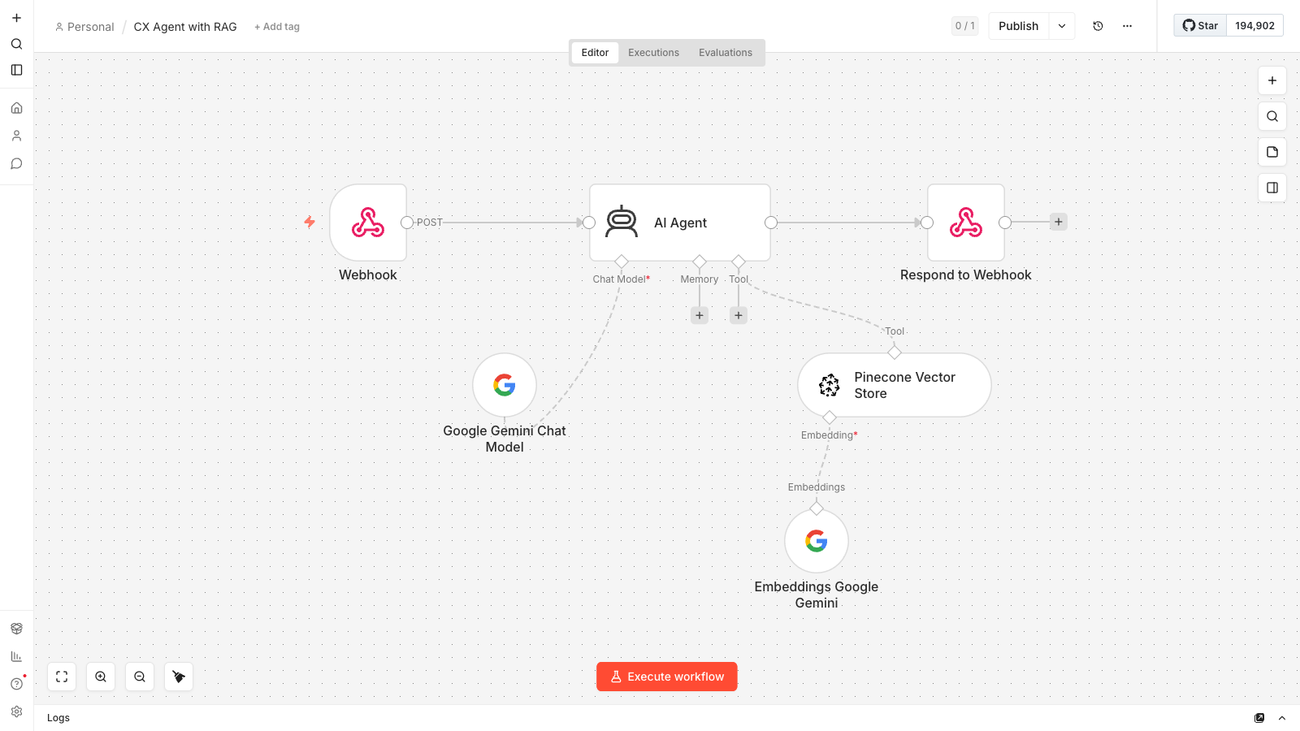
TOPIC 5 · LAB WORKFLOW
Activity 7b — CX Agent: Grounded Support Chatbot
The answering half: the website chat widget POSTs each question; the agent retrieves matching brochures and answers grounded.
Webhook — POST
website chat widget
AI Agent
Pinecone retriever tool + Gemini
Respond to Webhook
grounded answer to the widget
▶
▶
ACT 7b
CX Agent: Grounded Support Chatbot
Same index, same embeddings, same namespace as ingestion · steps in the Learner Guide
Agentic AI Automation with n8n · TGS-2023035977
© 2026 Tertiary Infotech Academy Pte Ltd
82

Slide 84

ACT 7b · THE WEBSITE
Cook & Bake Academy — Support Chatbot
• A one-page training-center site with a floating chat widget.
• Visitors ask about any course — duration, fee, location, schedule.
• Answers are grounded in the 20 ingested brochures.
• Set WEBHOOK_URL in script.js to your n8n CX Agent Production URL.
Agentic AI Automation with n8n · TGS-2023035977
© 2026 Tertiary Infotech Academy Pte Ltd
83

Slide 85
Tea Break
15 minutes
Agentic AI Automation with n8n · TGS-2023035977
© 2026 Tertiary Infotech Academy Pte Ltd
84

Slide 86
06
TOPIC 6
Security, Human-in-the-Loop & Guardrails
Where the human belongs · approval gates · input and output guardrails
Applied in Activities 8a, 8b and 8c
Agentic AI Automation with n8n · TGS-2023035977
© 2026 Tertiary Infotech Academy Pte Ltd
85

Slide 87
TOPIC 6 · SECURITY & GOVERNANCE
Human In, On, and Out of the Loop
Three arrangements people use interchangeably — and they are not the same thing.
Pattern
Who decides
Who acts
Can AI proceed alone?
Human IN the loop
AI proposes, human decides
Human approves, system acts
NO — it blocks
Human ON the loop
AI decides and acts
Human monitors, can intervene
Yes — reviewed after
Human OUT of the loop
AI decides and acts
AI acts
Yes — nobody checks
WHERE THIS COURSE PUTS THE HUMAN
Activity 8a — the manager approves leave before any email goes to the employee (IN the loop). The dashboard (8b) and chatbot (8c) run alone, but the chatbot is fenced by guardrails on both sides.
Ask who pays for the mistake — that answer sizes the agent's authority and places the human.
Agentic AI Automation with n8n · TGS-2023035977
© 2026 Tertiary Infotech Academy Pte Ltd
86

Slide 88
TOPIC 6 · SECURITY & GOVERNANCE
How an Approval Suspends a Running Flow
n8n's Send and Wait for Response physically pauses the workflow until a person clicks.
Request submitted
employee applies for leave
Send & Wait
manager gets Approve / Decline email
The run SUSPENDS
minutes or days — it waits
A person responds
one click in the email
IF reads the outcome
approved → notify · declined → notify
▶
▶
▶
▶
Outcome = Approve
Outcome = Decline
Ack first
Send the approval email, update the record, continue the business process.
Send the rejection with the manager's comments — never silence.
The portal gets an instant 'received' response BEFORE the wait — the browser never hangs on a manager.
A pause that is still paused tomorrow is a real gate — that is the deliverable of Activity 8a.
Agentic AI Automation with n8n · TGS-2023035977
© 2026 Tertiary Infotech Academy Pte Ltd
87

Slide 89
TOPIC 6 · SECURITY & GOVERNANCE
Guardrails — Two Gates Around the Agent
An LLM checks every message in, and every reply out — the agent only sees and says what passes.
User message
from the HR portal
INPUT guardrail
LLM: ALLOW / BLOCK
HR AI Agent
answers in-scope questions
OUTPUT guardrail
LLM: SAFE / LEAK
Reply or blocked
user sees the safe path
▶
▶
▶
▶
1
Input (pre) guardrail blocks
2
Output (post) guardrail blocks
Prompt injection ('ignore previous instructions'), jailbreaks, requests for another person's salary or private data.
Salary figures, NRIC, credentials, system-instruction leaks — even when the agent was tricked into producing them.
Instructions say what the agent SHOULD do; guardrails enforce what it MUST NOT — you need both.
Agentic AI Automation with n8n · TGS-2023035977
© 2026 Tertiary Infotech Academy Pte Ltd
88

Slide 90
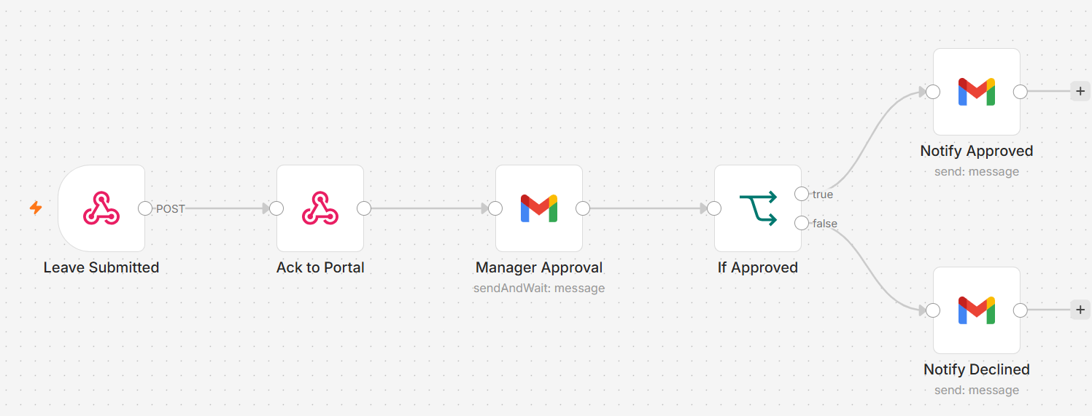
TOPIC 6 · LAB WORKFLOW
Activity 8a — Leave Application & Manager Approval (HITL)
The employee applies on the portal; the flow acks, then suspends until the manager clicks Approve or Decline in email.
Webhook — POST
hr-leave-apply
Respond — Ack
portal gets instant OK
Gmail — Send & Wait
manager: Approve / Decline
IF
approved = true ?
Gmail
notify the employee
▶
▶
▶
▶
ACT 8a
Leave Application & Manager Approval (HITL)
Human-in-the-loop gate · run suspends until the click · steps in the Learner Guide
Agentic AI Automation with n8n · TGS-2023035977
© 2026 Tertiary Infotech Academy Pte Ltd
89

Slide 91
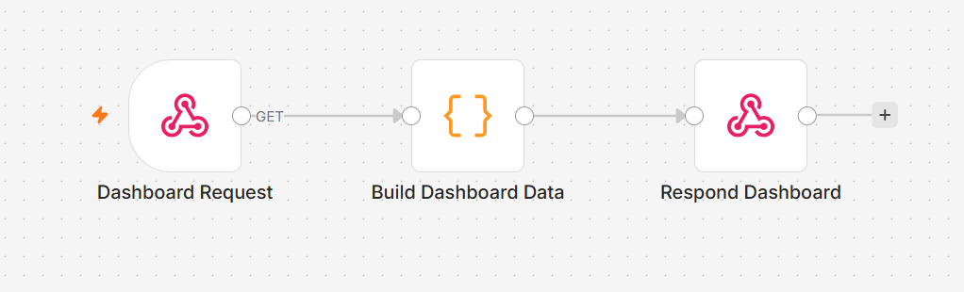
TOPIC 6 · LAB WORKFLOW
Activity 8b — HR Dashboard Data (GET Webhook)
A GET webhook powers the portal's Dashboard tab — leave balance and history returned as JSON to the browser.
Webhook — GET
hr-dashboard?email=…
Code
build the leave-data JSON
Respond to Webhook
JSON back to the portal
▶
▶
ACT 8b
HR Dashboard Data (GET Webhook)
GET query read from $json.query.email · CORS = * · steps in the Learner Guide
Agentic AI Automation with n8n · TGS-2023035977
© 2026 Tertiary Infotech Academy Pte Ltd
90

Slide 92
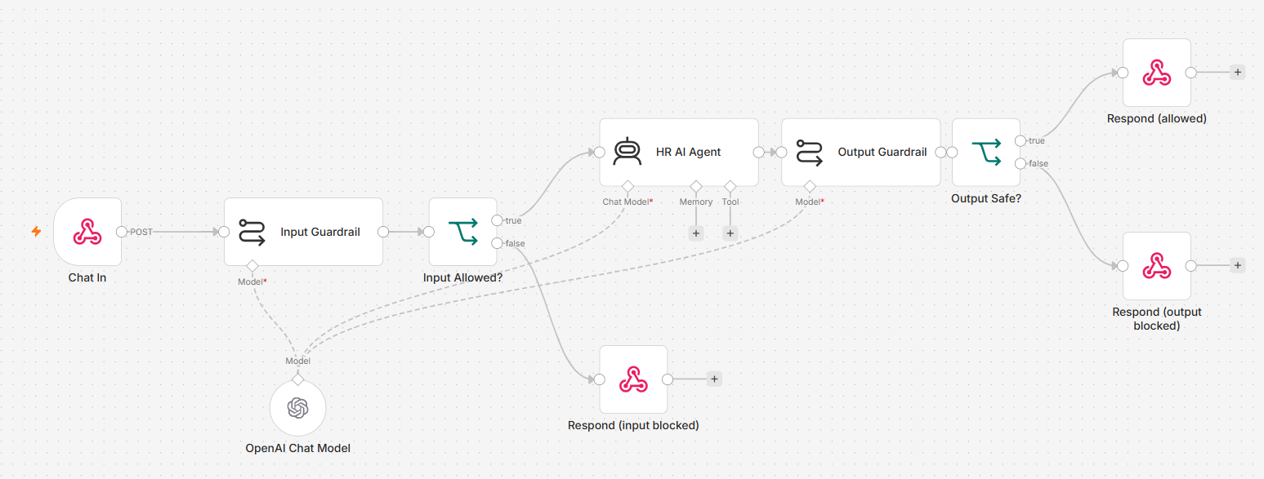
TOPIC 6 · LAB WORKFLOW
Activity 8c — AI Chatbot with Input & Output Guardrails
HR Buddy answers general HR questions — every message passes the input gate, every reply passes the output gate.
Webhook — POST
hr-chat
Input Guardrail
LLM: ALLOW / BLOCK
HR AI Agent
leave · payroll · claims
Output Guardrail
LLM: SAFE / LEAK
Respond
reply or blocked message
▶
▶
▶
▶
ACT 8c
AI Chatbot with Input & Output Guardrails
Test it by trying to break it — the injection probe must be blocked · steps in the Learner Guide
Agentic AI Automation with n8n · TGS-2023035977
© 2026 Tertiary Infotech Academy Pte Ltd
91

Slide 93
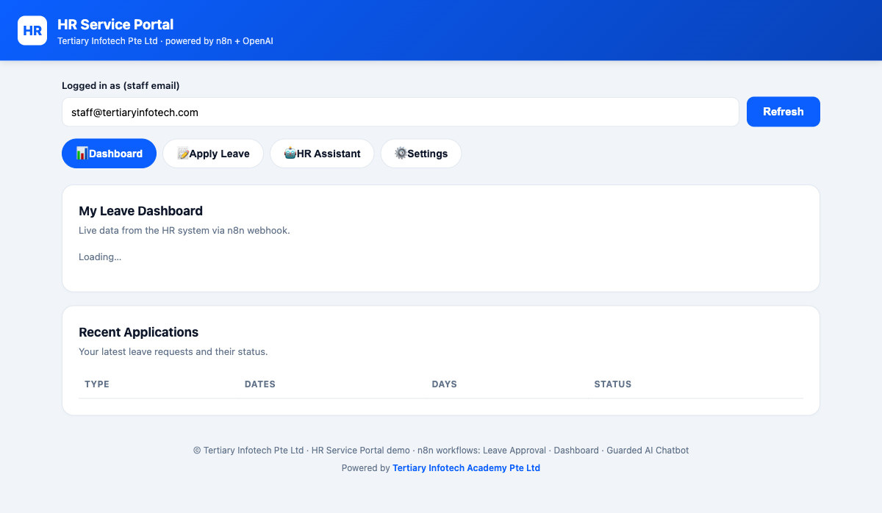
ACT 8 · THE WEBSITE
Activity 8 — The HR Service Portal
• One portal with four tabs: Dashboard, Apply Leave, HR Assistant, Settings.
• Dashboard pulls live leave balance & history from the GET webhook (8b).
• Apply Leave triggers the human-in-the-loop approval chain (8a).
• HR Assistant is the guarded AI chatbot — input & output guardrails (8c).
Agentic AI Automation with n8n · TGS-2023035977
© 2026 Tertiary Infotech Academy Pte Ltd
92

Slide 94
Lunch Break
1 hour
Agentic AI Automation with n8n · TGS-2023035977
© 2026 Tertiary Infotech Academy Pte Ltd
93

Slide 95
07
TOPIC 7
Mini Capstone Project
Design · Build · Present
Everything from Activities 1–8, your problem
Agentic AI Automation with n8n · TGS-2023035977
© 2026 Tertiary Infotech Academy Pte Ltd
94

Slide 96
TOPIC 7 · MINI CAPSTONE
Your Build — What It Must Include
In small groups, design and build an end-to-end automation for a problem you choose.
1
A trigger
2
An AI agent
Form, webhook, Telegram or schedule — who or what starts your process?
With at least one tool or a RAG source — the judgement in the middle.
3
External data or storage
4
A control
An API you call, or storage you write — Sheets, a vector DB, a Data Table.
A guardrail or a human-in-the-loop step — decide where the human belongs and defend it.
Deliverables: a working workflow, a short demo, and a 3–5 minute presentation.
Agentic AI Automation with n8n · TGS-2023035977
© 2026 Tertiary Infotech Academy Pte Ltd
95

Slide 97
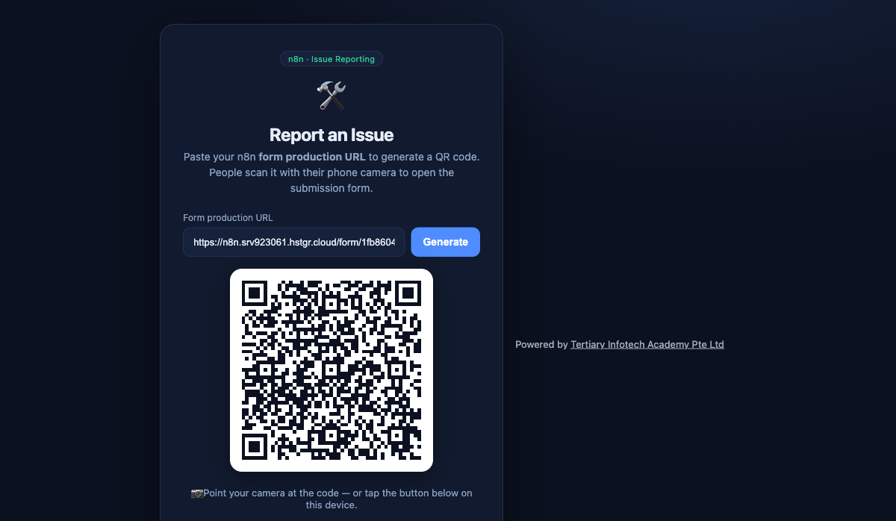
CAPSTONE · WORKED EXAMPLE
Capstone Example — Issue Reporting
• Paste your n8n Form production URL to generate a QR code.
• People scan the QR with a phone to open the submission form.
• Submissions (with photos) flow into Postgres and a public gallery.
• A complete worked capstone you can adapt for your own project.
Agentic AI Automation with n8n · TGS-2023035977
© 2026 Tertiary Infotech Academy Pte Ltd
96

Slide 98
WRAP-UP
Presentation & Assessment
• Present the problem, your design, and what you'd improve.
• Written Assessment (SAQ) — 1 hour · Practical Performance (PP) — 1 hour.
• Open book: slides, Learner Guide and approved materials.
• Remember to take the Assessment digital attendance (TRAQOM).
Agentic AI Automation with n8n · TGS-2023035977
© 2026 Tertiary Infotech Academy Pte Ltd
97

Slide 99
FINAL ASSESSMENT
Assessment
• Written Assessment (SAQ) — 1 hour. Practical Performance (PP) — 1 hour.
• Open book: slides, Learner Guide and approved materials only.
• Remember to take the Assessment digital attendance (TRAQOM).
• Submit your completed answers on the LMS at https://lms-tms.tertiaryinfotech.com/.
Agentic AI Automation with n8n · TGS-2023035977
© 2026 Tertiary Infotech Academy Pte Ltd
98

Slide 100
ON ASSESSMENT DAY
Assessment Flow
1
2
3
4
5
▶
▶
▶
▶
TRAQOM survey — scan the QR code on the LMS
Assessment digital attendance — scan the SSG QR
Sit WA (SAQ) then PP — open book
Submit your answers on the LMS
Sign the Assessment Summary Record
Agentic AI Automation with n8n · TGS-2023035977
© 2026 Tertiary Infotech Academy Pte Ltd
99

Slide 101
TRAQOM · SSG DIGITAL ATTENDANCE
Digital Attendance (Mandatory)
• It is mandatory to take the AM, PM and Assessment digital attendance for WSQ-funded courses.
• The trainer/administrator displays the digital attendance QR code from the SSG portal.
• Scan the QR code with your mobile phone camera and submit your attendance.
• A minimum of 75% attendance is required to be eligible for assessment and funding.
Agentic AI Automation with n8n · TGS-2023035977
© 2026 Tertiary Infotech Academy Pte Ltd
100

Slide 102
Thank You!
Keep your local n8n running and keep building your own agents.
Download all flows: github.com/tertiarycourses/TGS-2023035977-Agentic-AI-Automation-with-n8n
Powered by Tertiary Infotech Academy Pte Ltd · www.tertiarycourses.com.sg
Agentic AI Automation with n8n · TGS-2023035977
© 2026 Tertiary Infotech Academy Pte Ltd
101

